Slide 1
Kafka Fundamentals

Slide 2
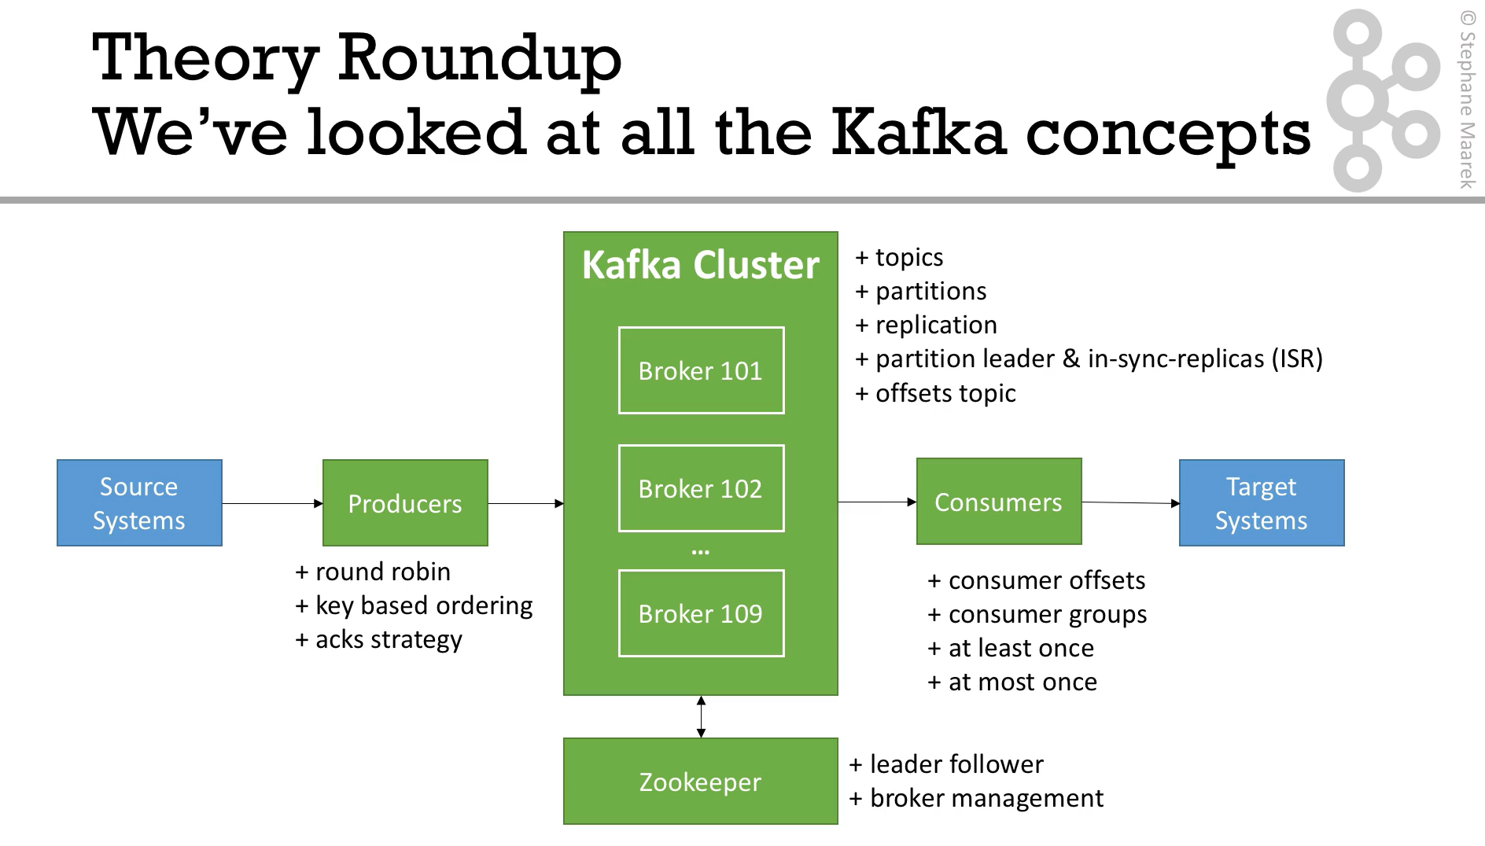

Slide 3
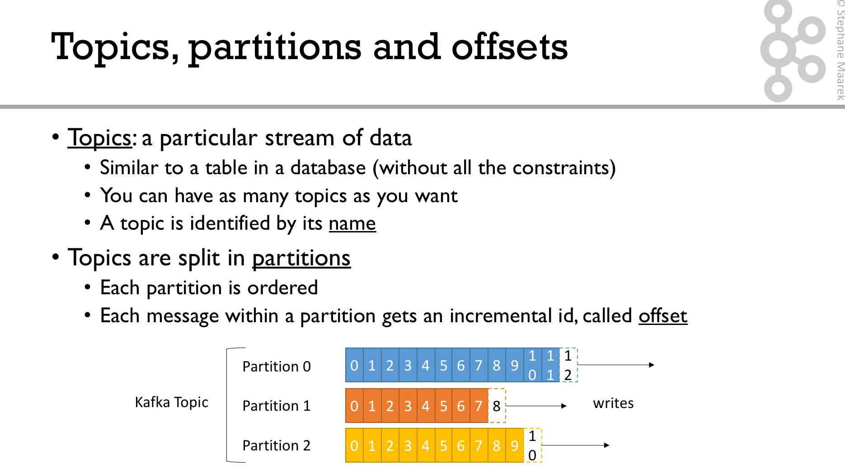

Slide 4
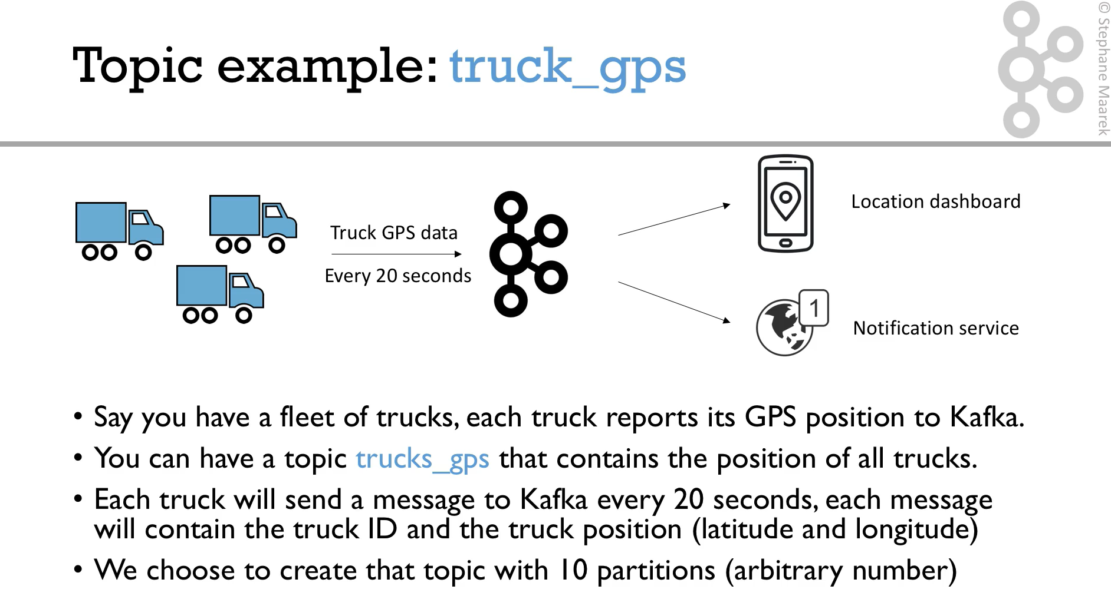

Slide 5
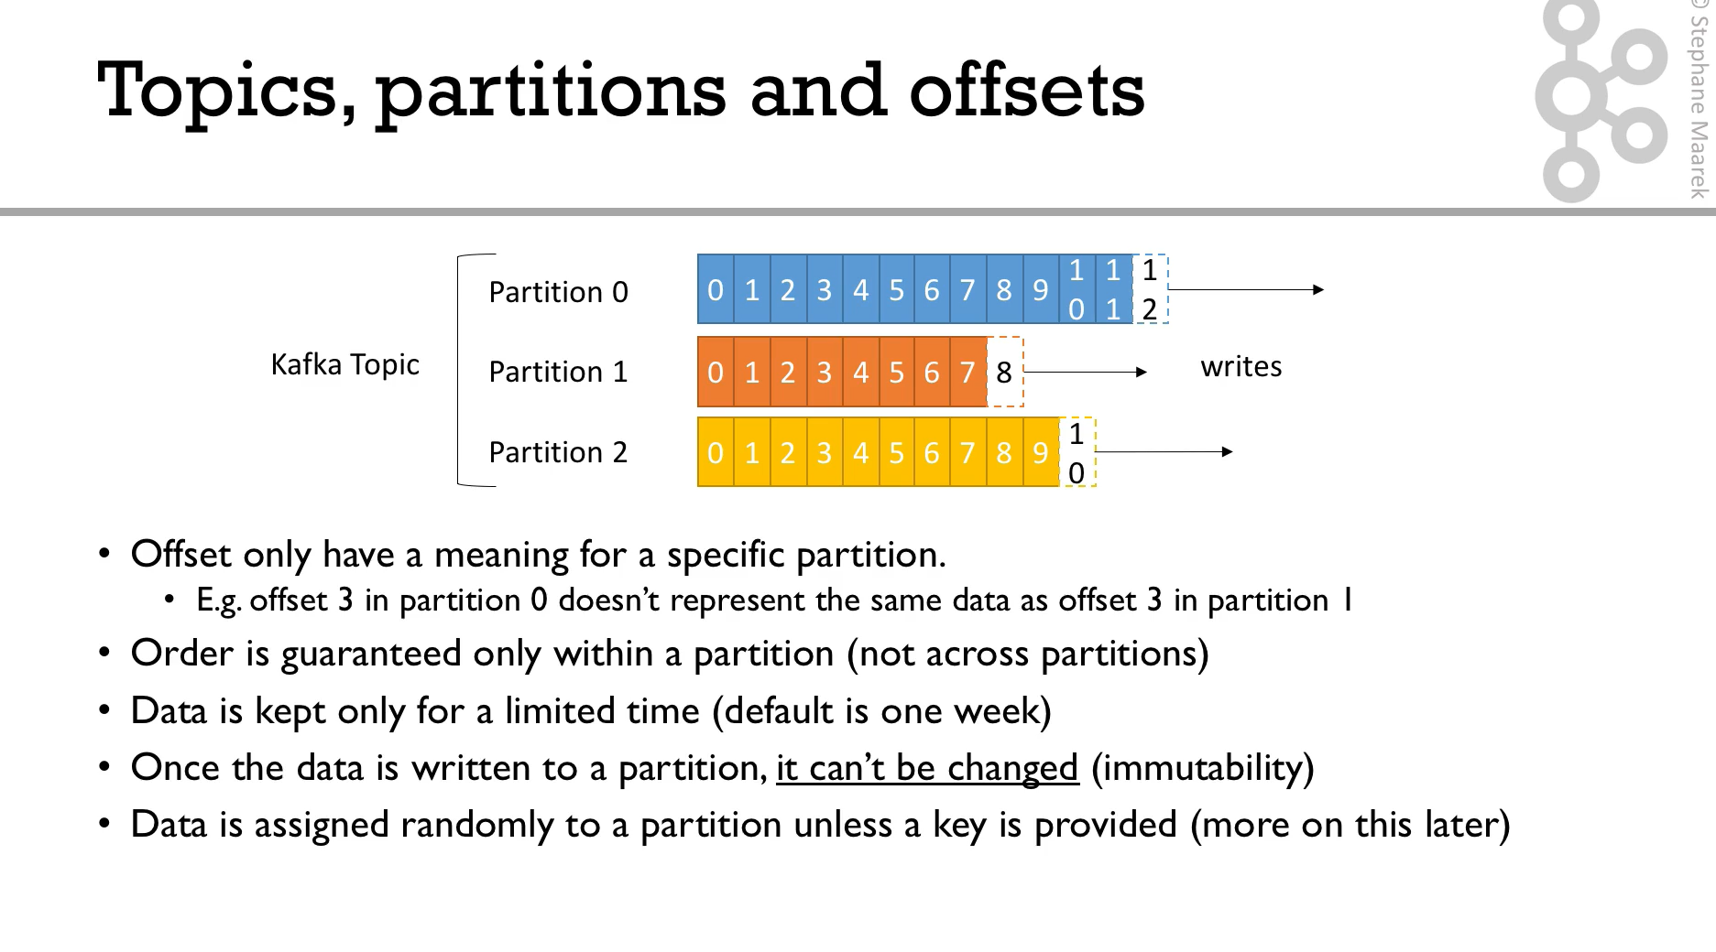

Slide 6
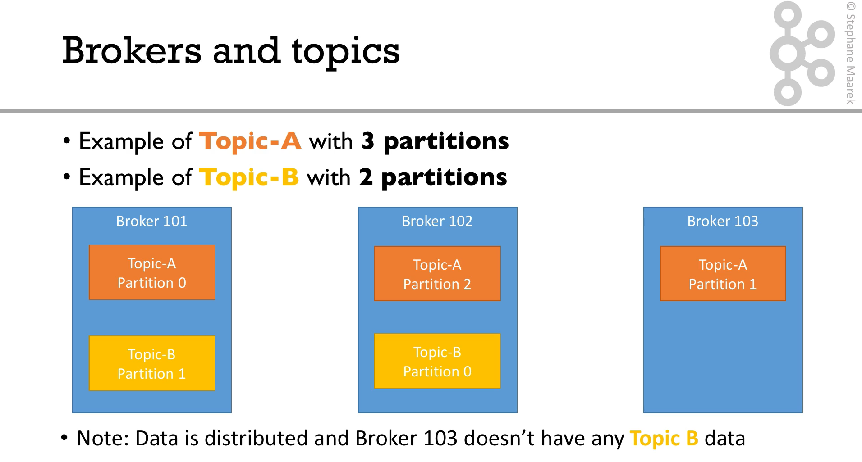

Slide 7
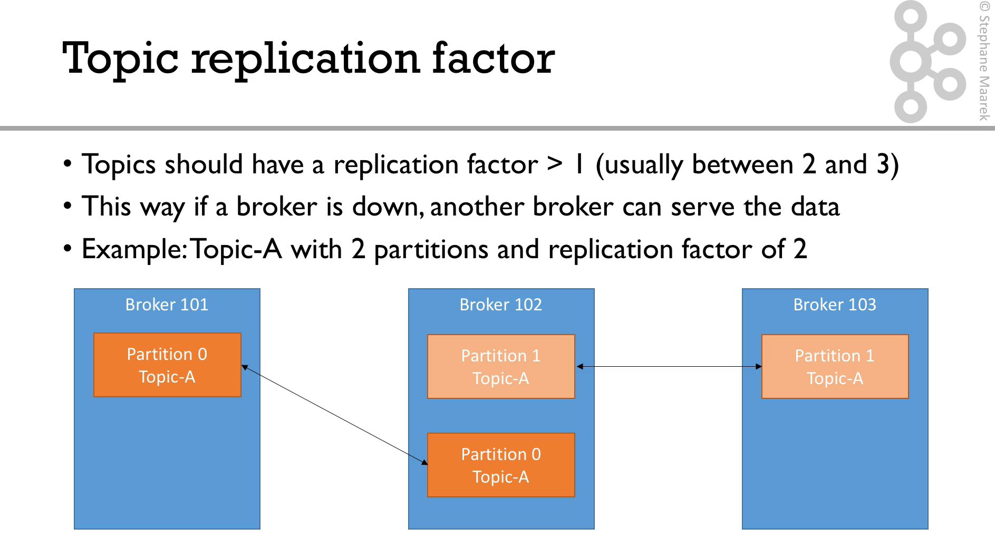

Slide 8
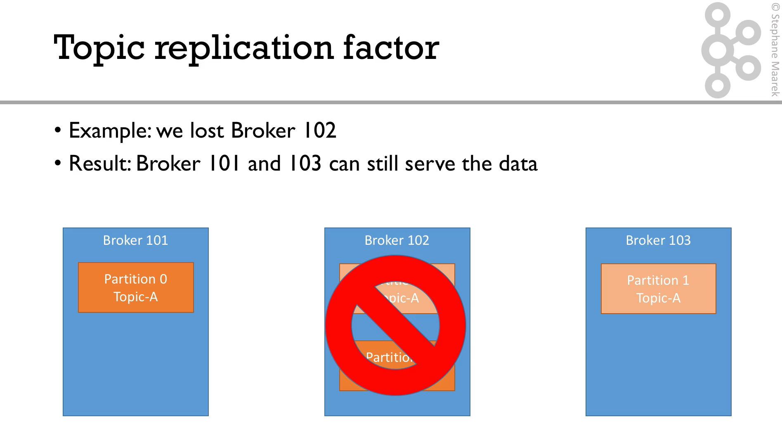

Slide 9
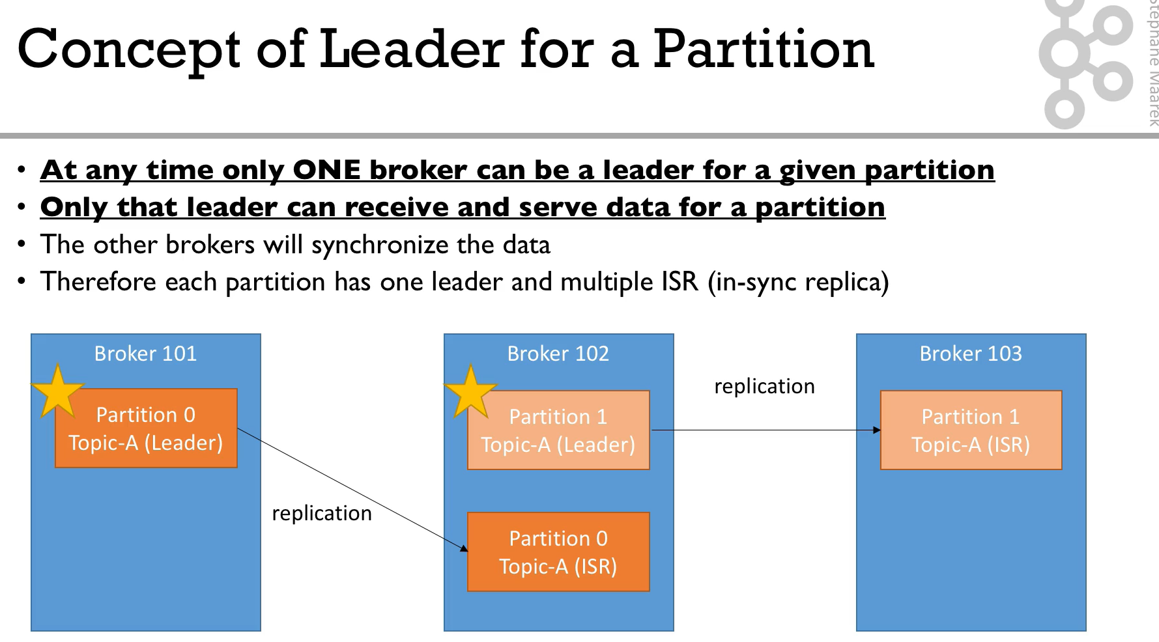

Slide 10
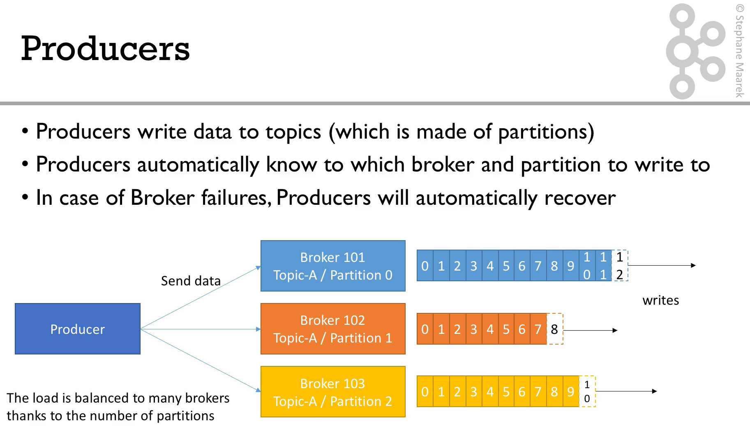

Slide 11
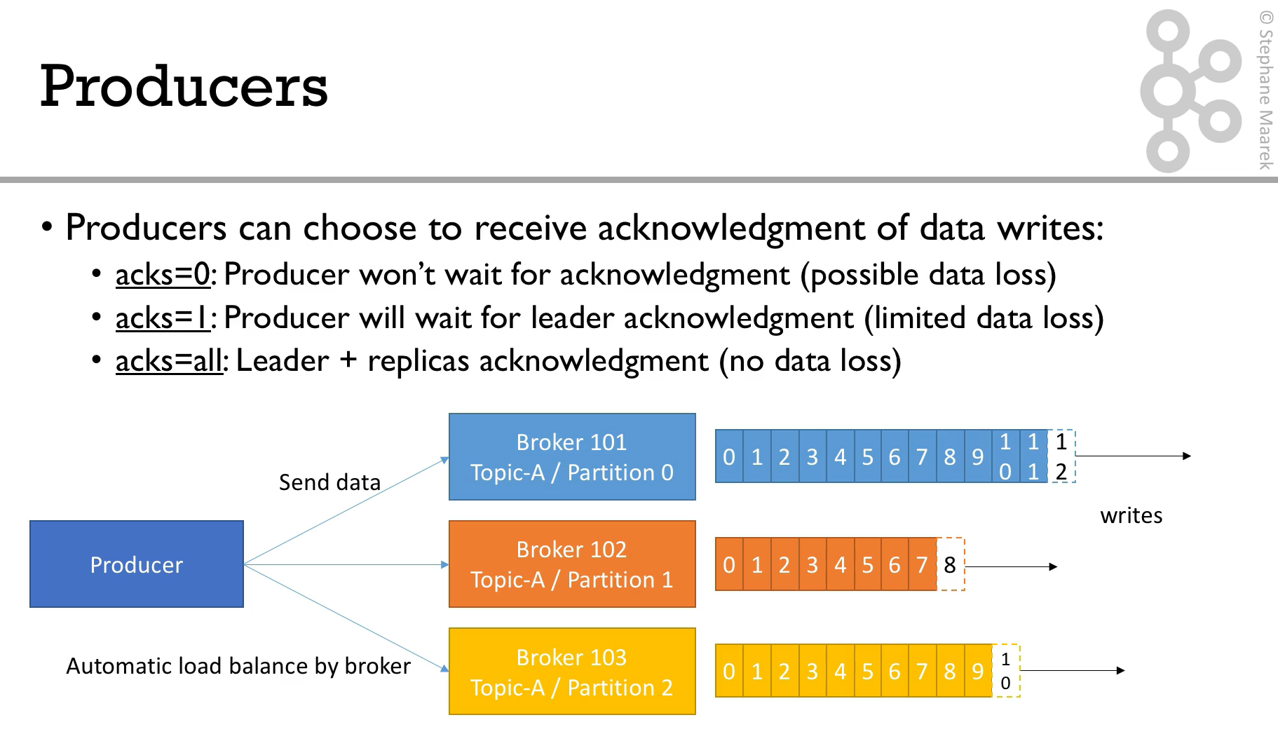

Slide 12
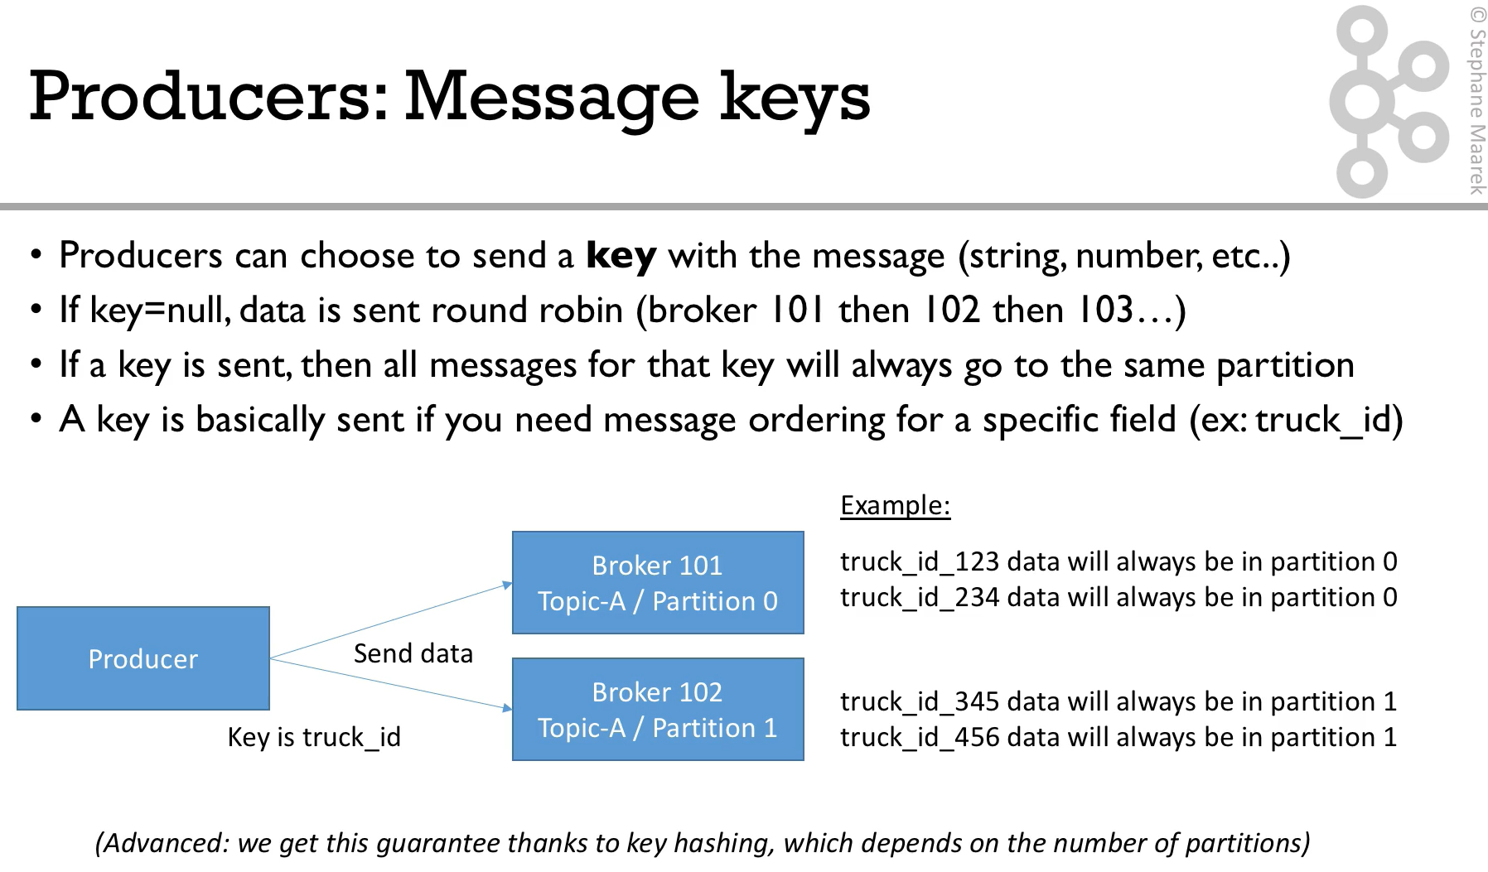

Slide 13
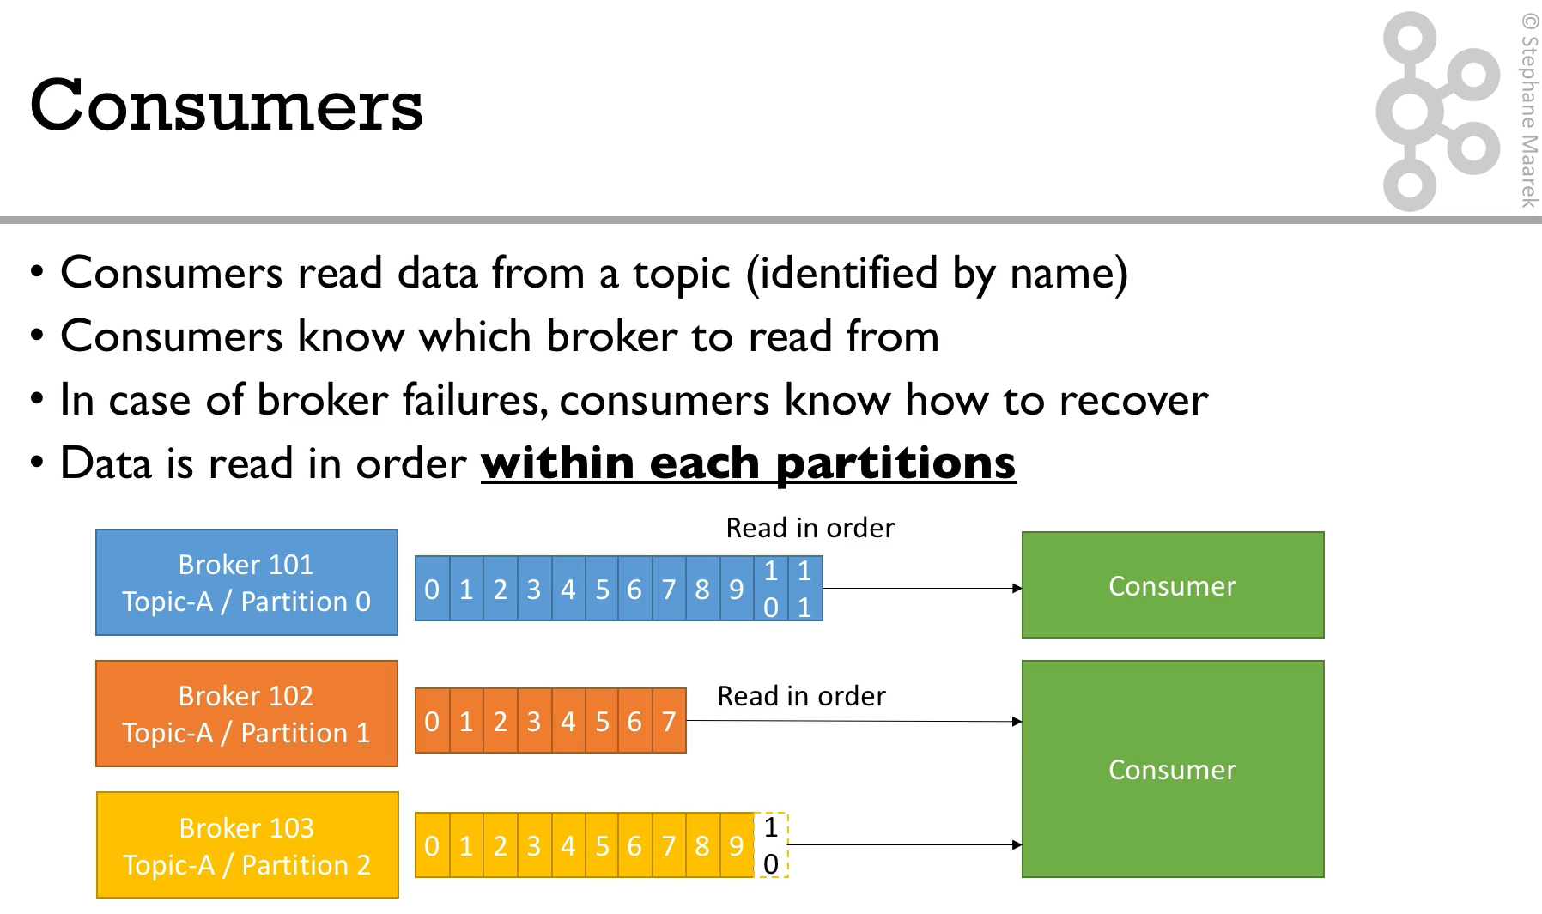

Slide 14
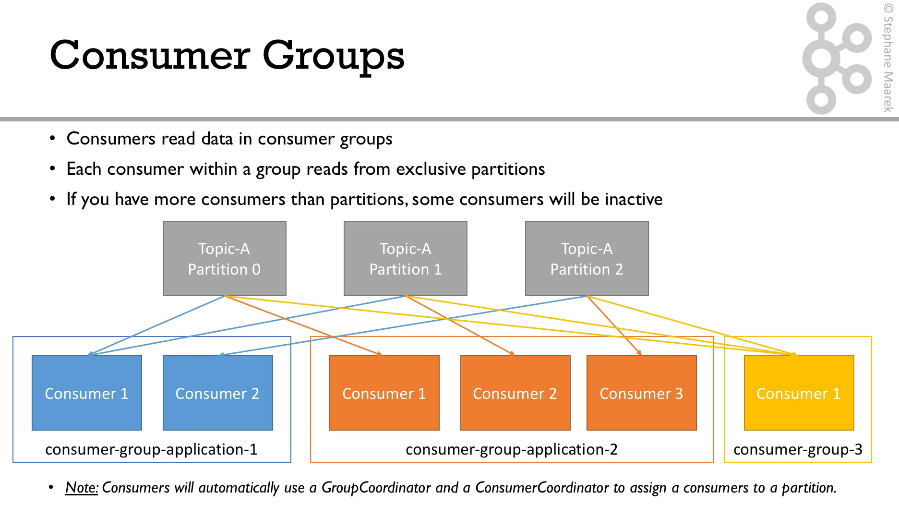

Slide 15
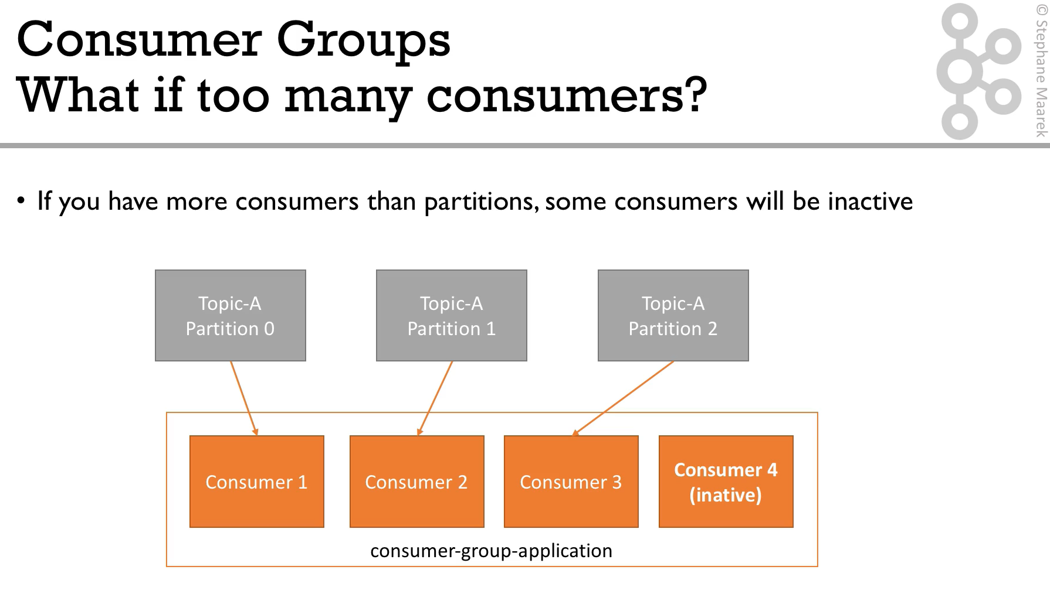

Slide 16
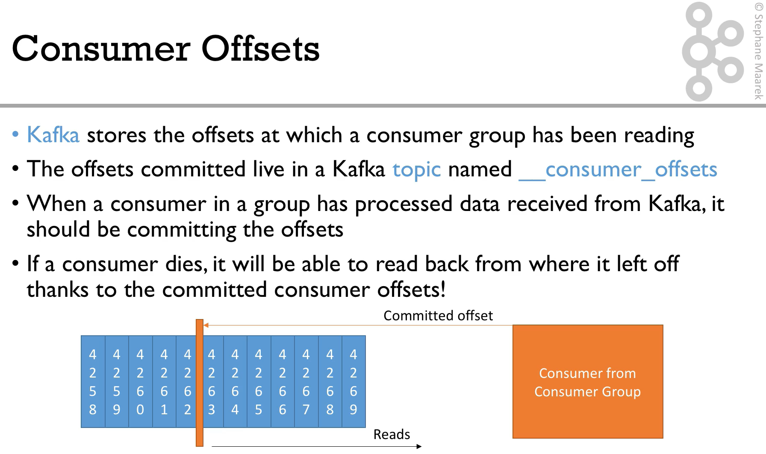

Slide 17
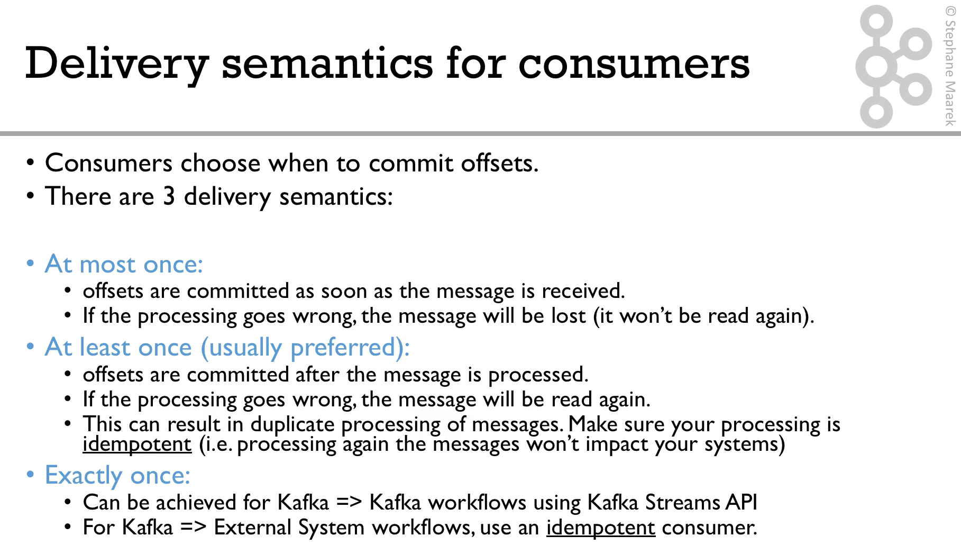

Slide 18
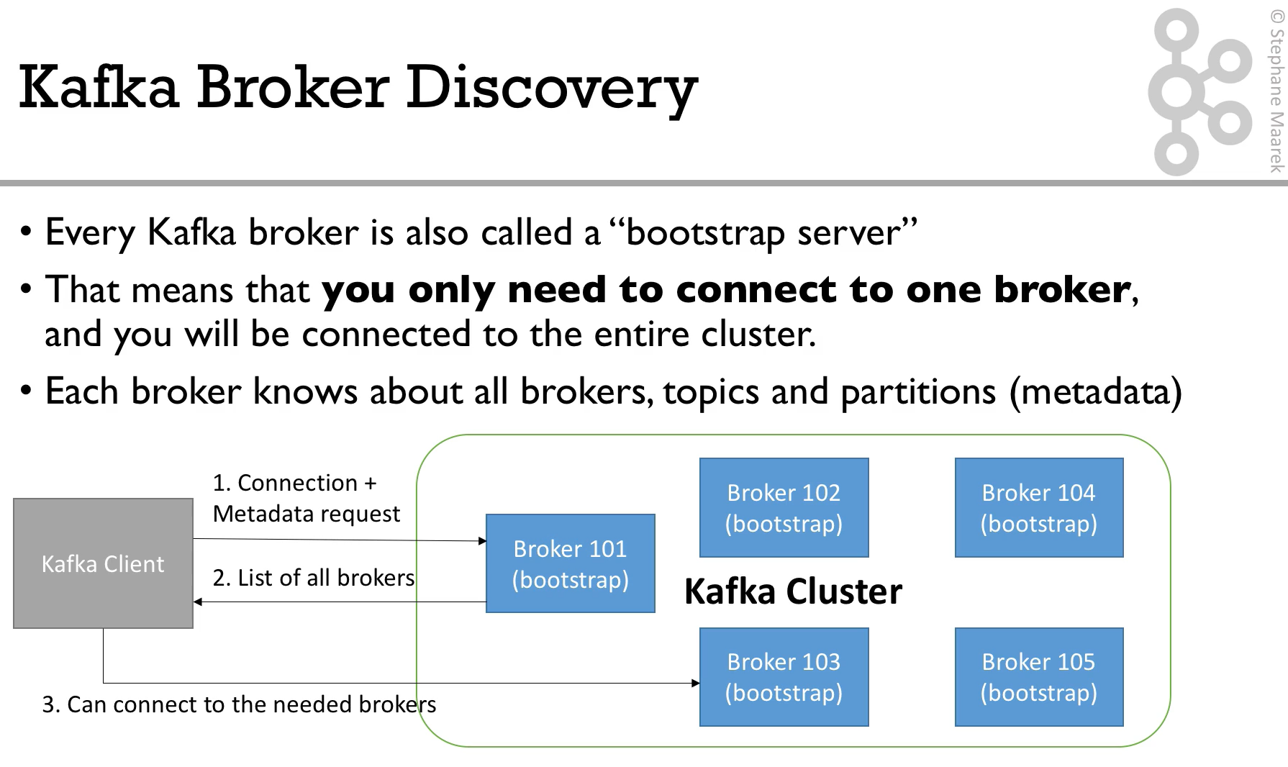
Notes:
This is something automatic that you should not be worried about, it’s internal functionality

Slide 19
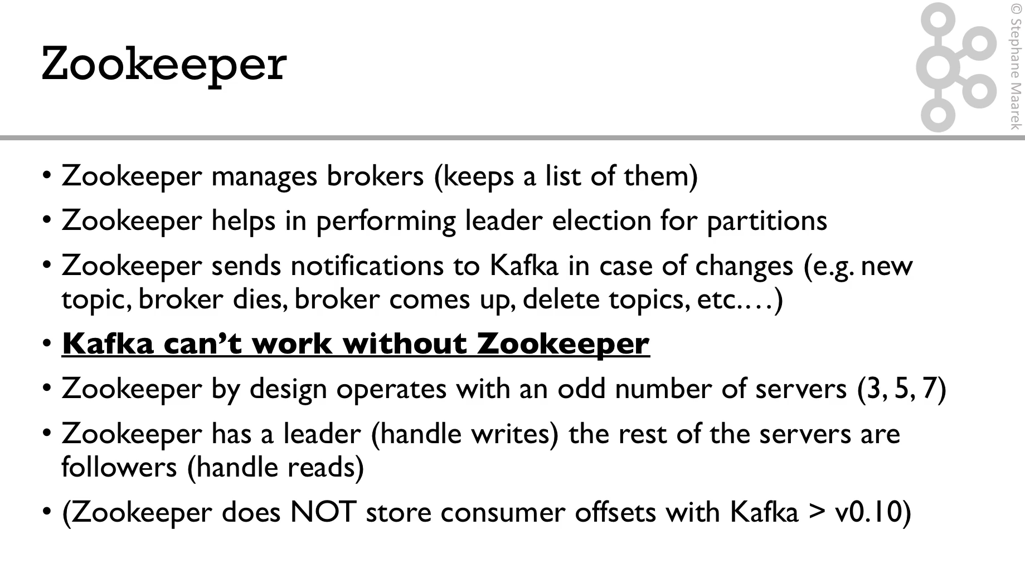

Slide 20
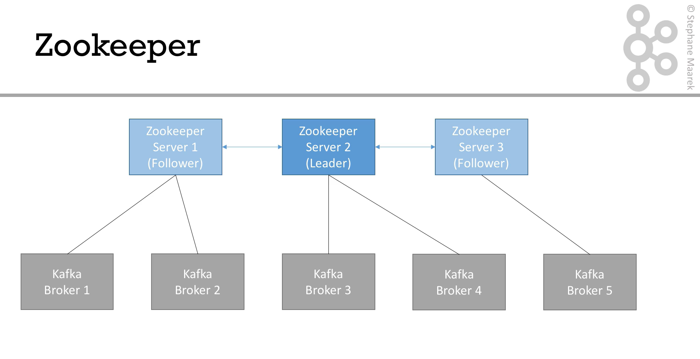

Slide 21
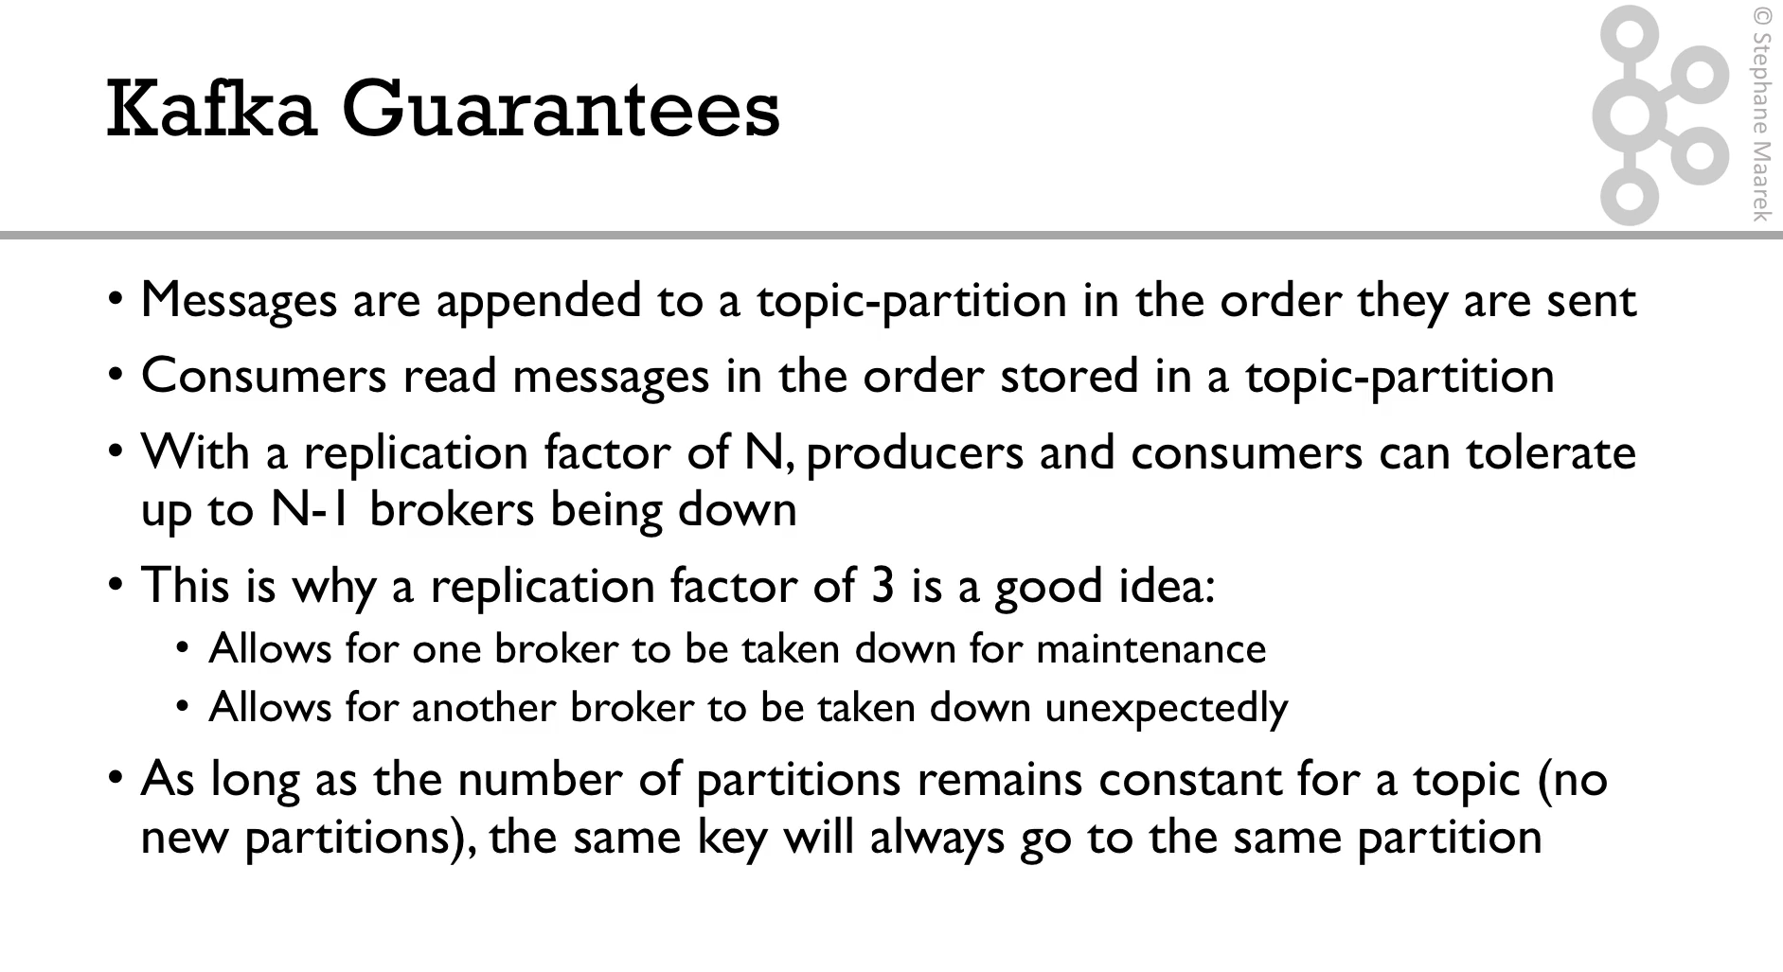

Slide 23
Producer Performance Configuration

Slide 24
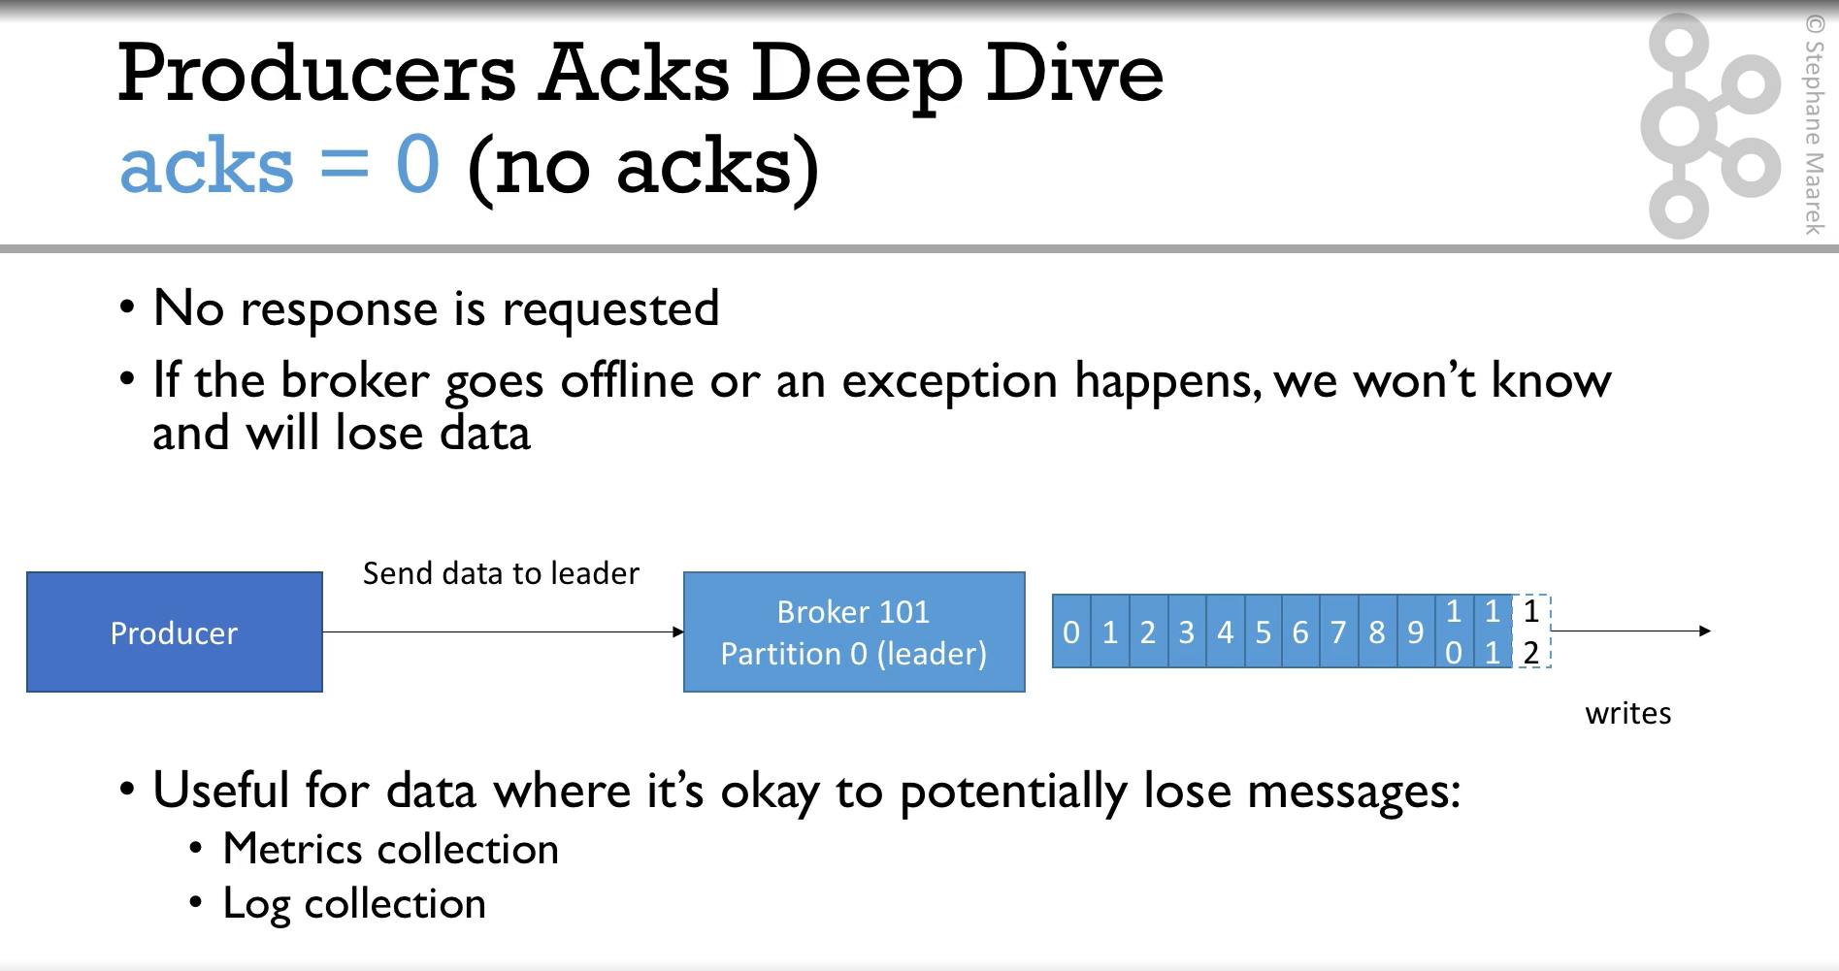

Slide 25
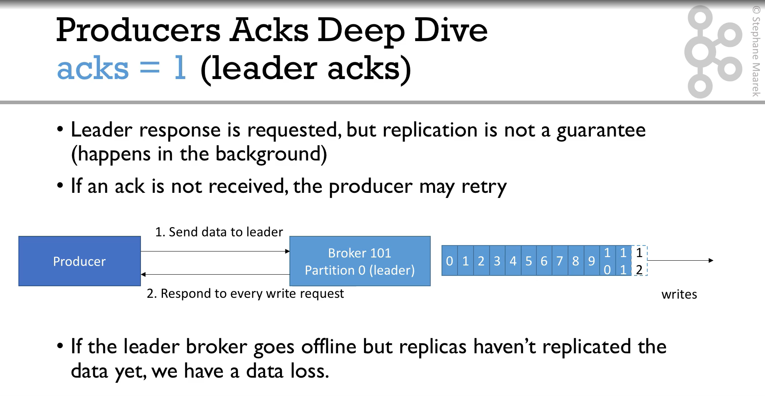

Slide 26
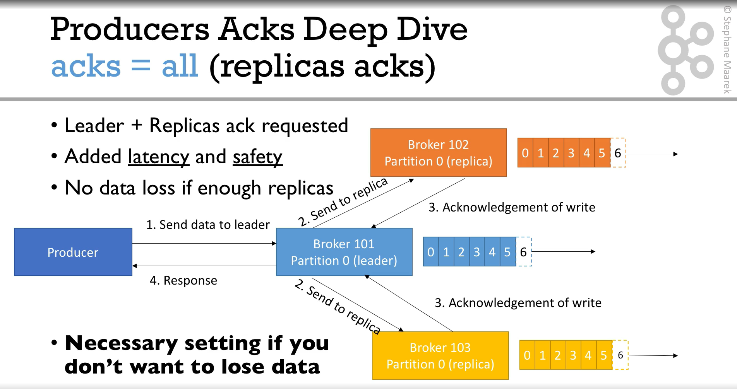
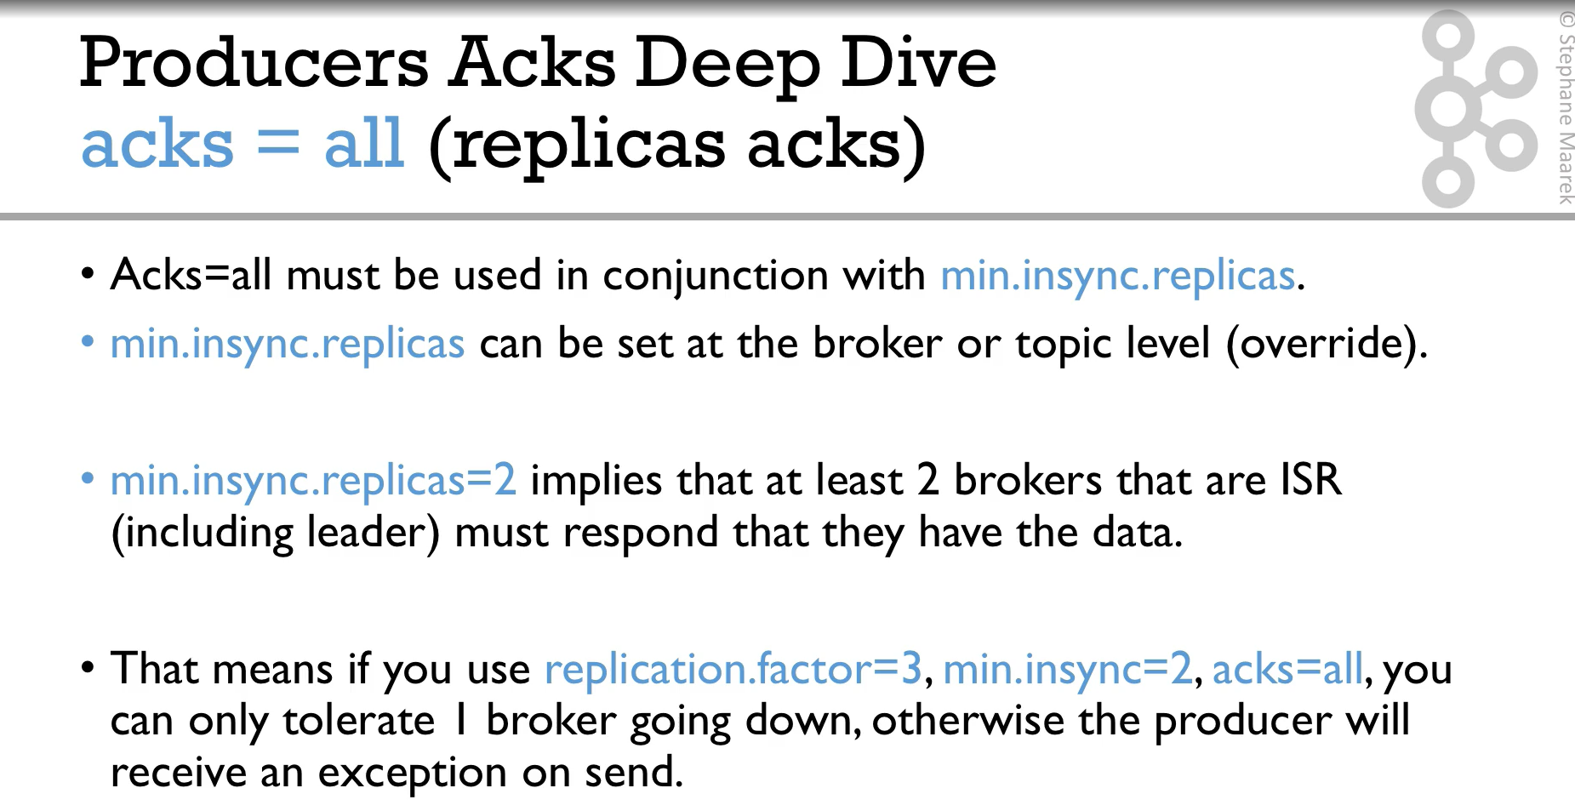
Notes:
ACK
Acknowlege from the consumer once they recevie a message
ack = 0 (no acks)
No response is requested
If the broker goes offline or an exception happens, we won't know and will lose data
Useful for data where it's okay to potentially lose messages:
Metrics collection
Log collection
ack = 1
Only leader acknowledge
Can present data los
ack = all
All the leader and replicas should ackowledge
No data lost
More latency
Goes in clunjuction with "min.insync.replicas"
min.insync.replicas = 2 => at least 2 brokers that are ISR must acknowledge
Example:
replication.factor=3; min.insync=2; acks=all
=> only tolerate 1 broker going down, otherwise the producer will receive an exception on send.

Slide 27
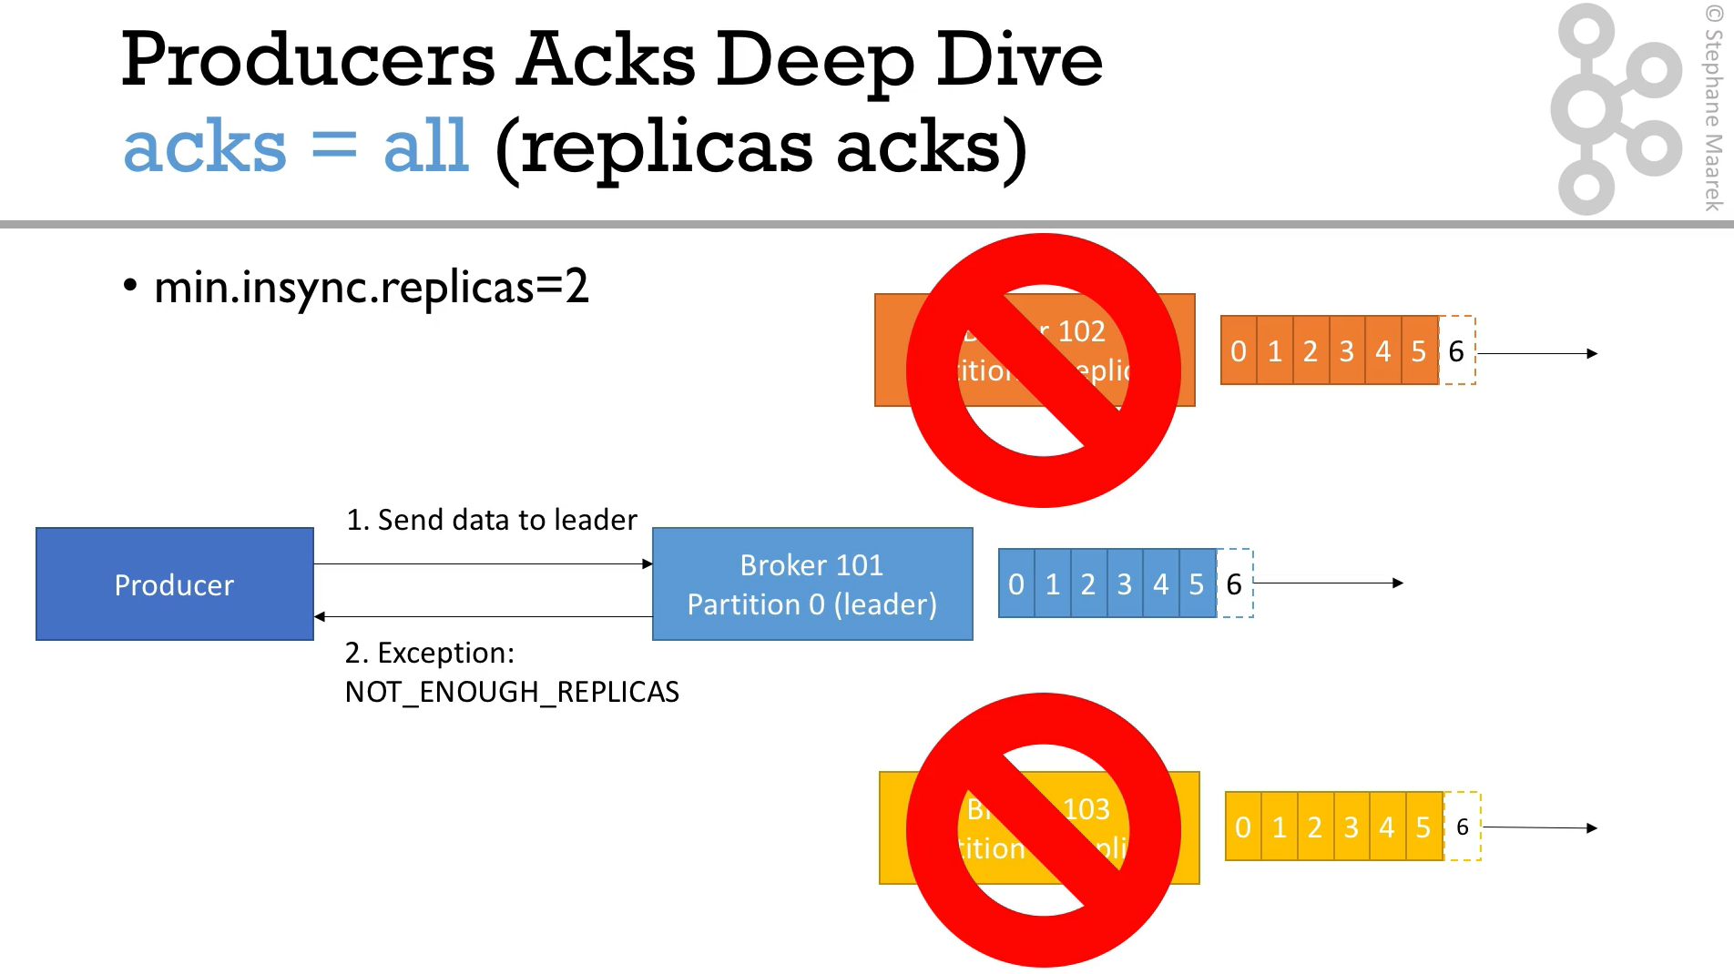

Slide 28
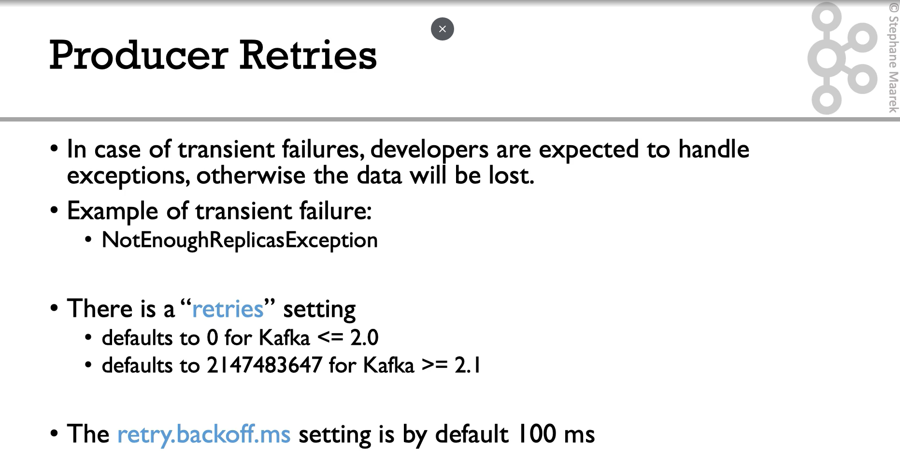

Slide 29
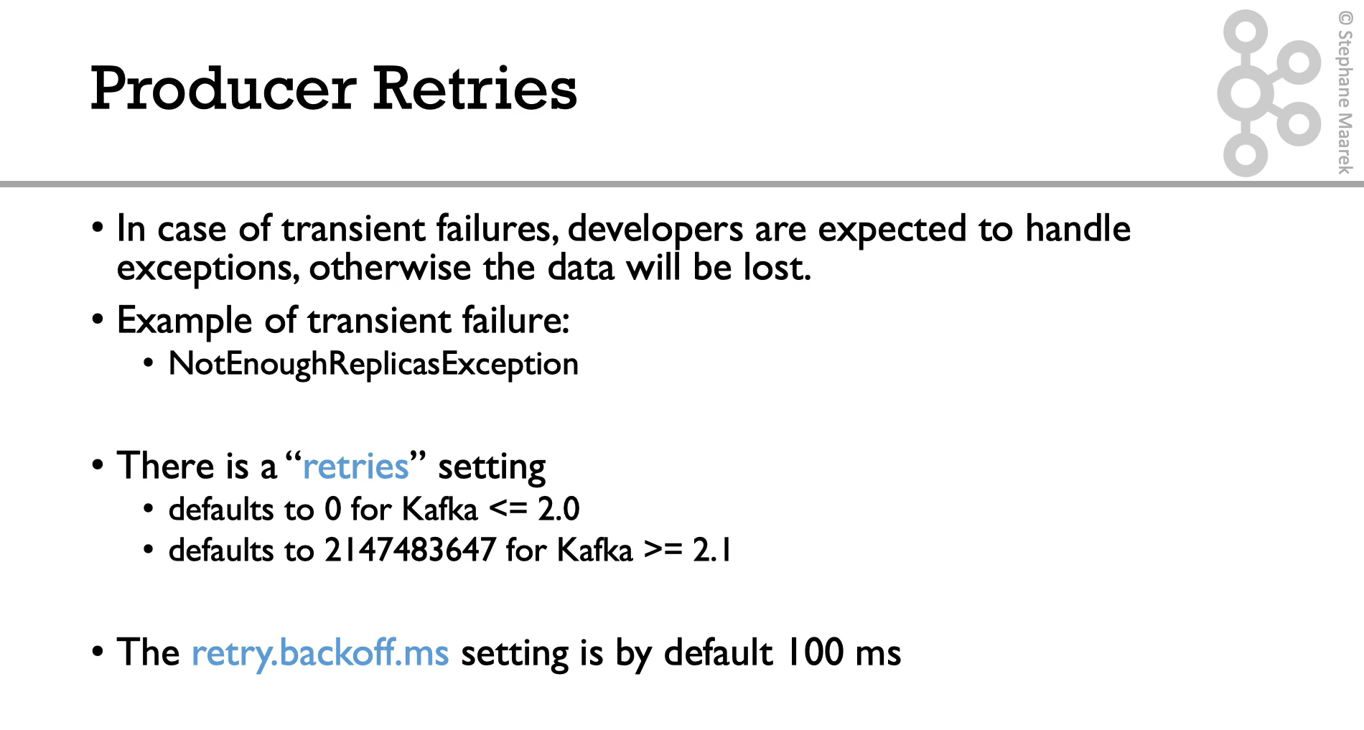
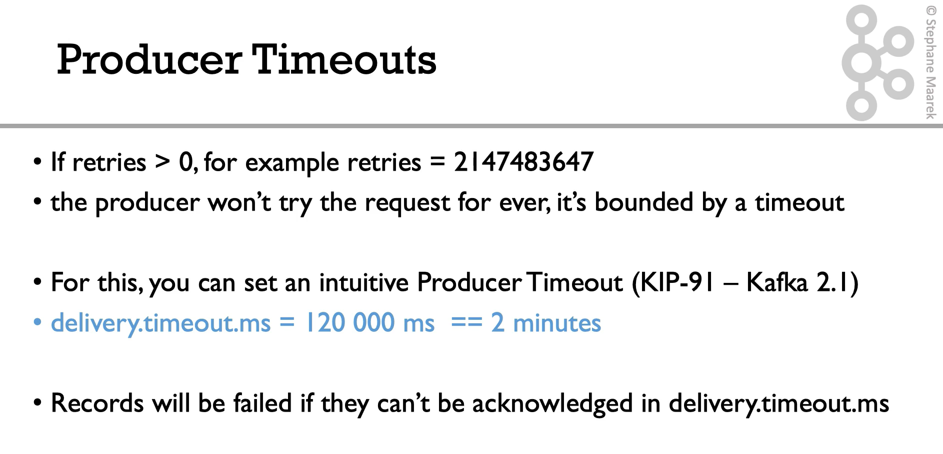
Notes:
Producer “retries”
Retries when a failure while producing a message
Default settins:
0 for kafka <= 2.0
2147483647 for kafka > 2.1
Goes in conjunction with “retry.backoff.ms”
Each retry will be sent every “retry.backoff.ms” milliseconds
Default setting:
100 ms
And “delivery.timeout.ms”
Preferable way for controlling retry behaviour, the producer will retry until the “delivery.timeout.ms” is met

Slide 30
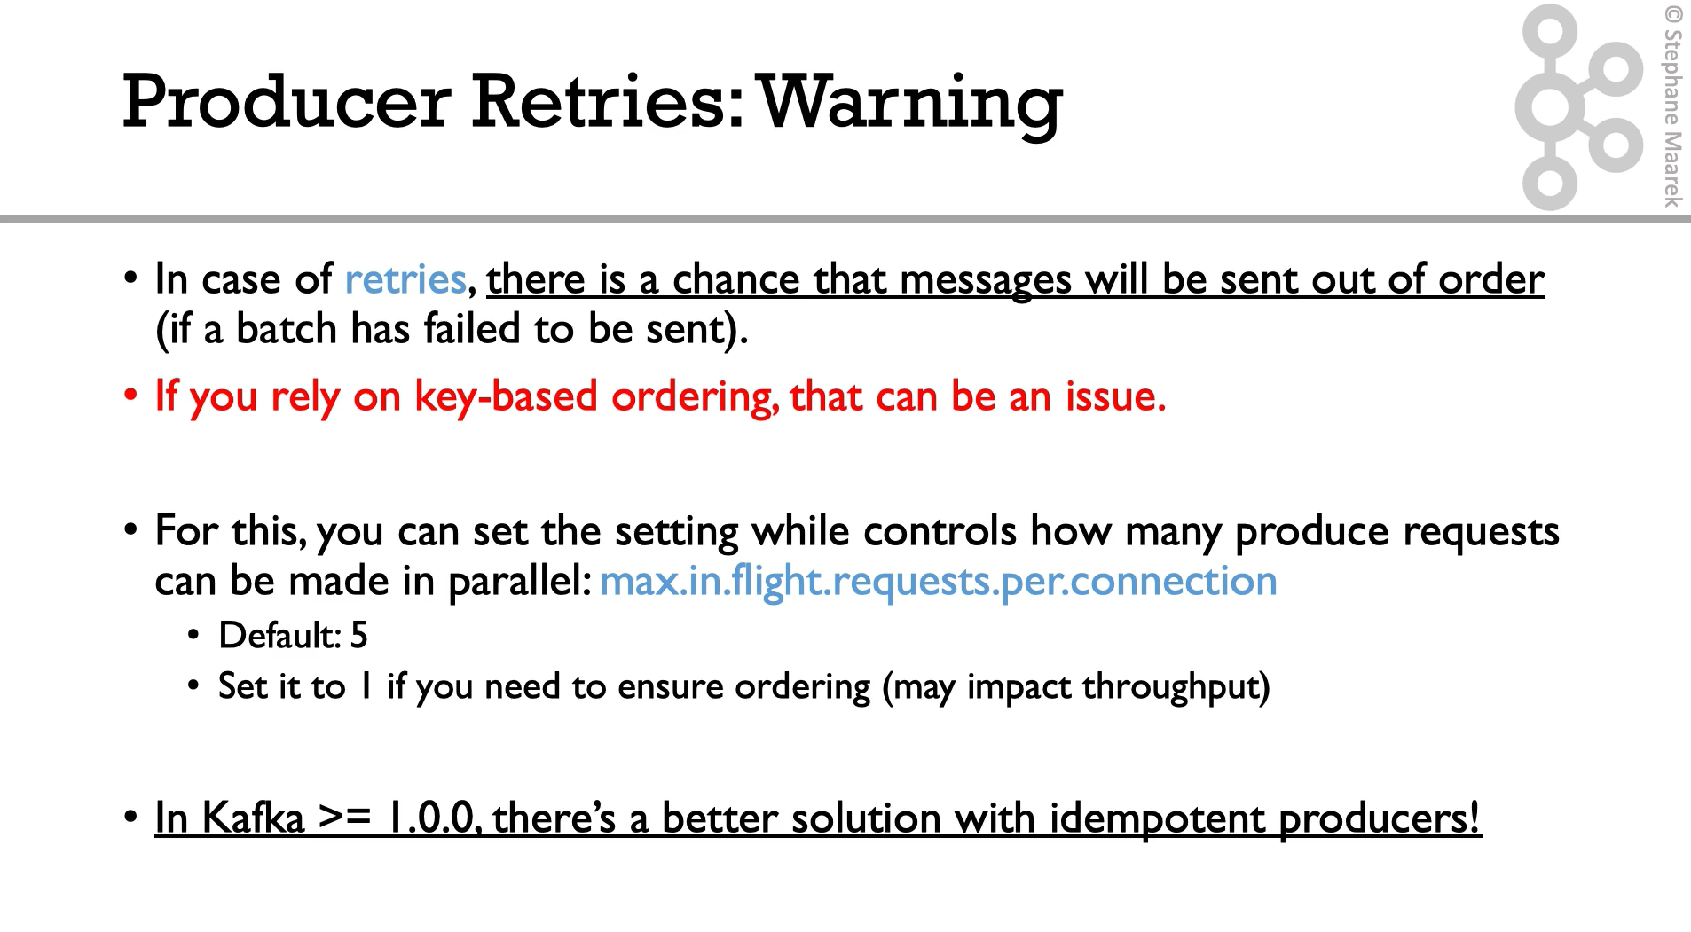

Slide 31
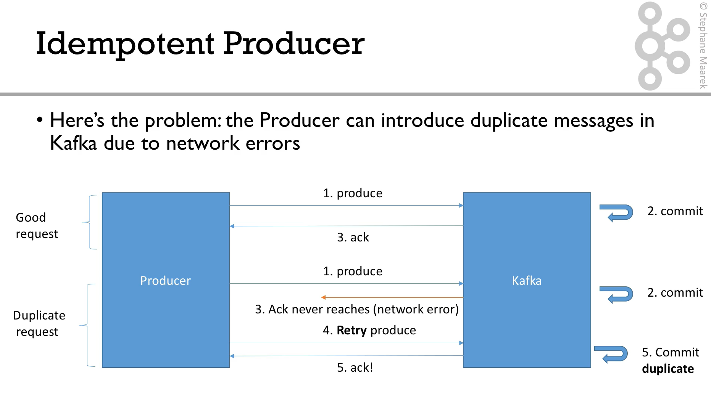

Slide 32
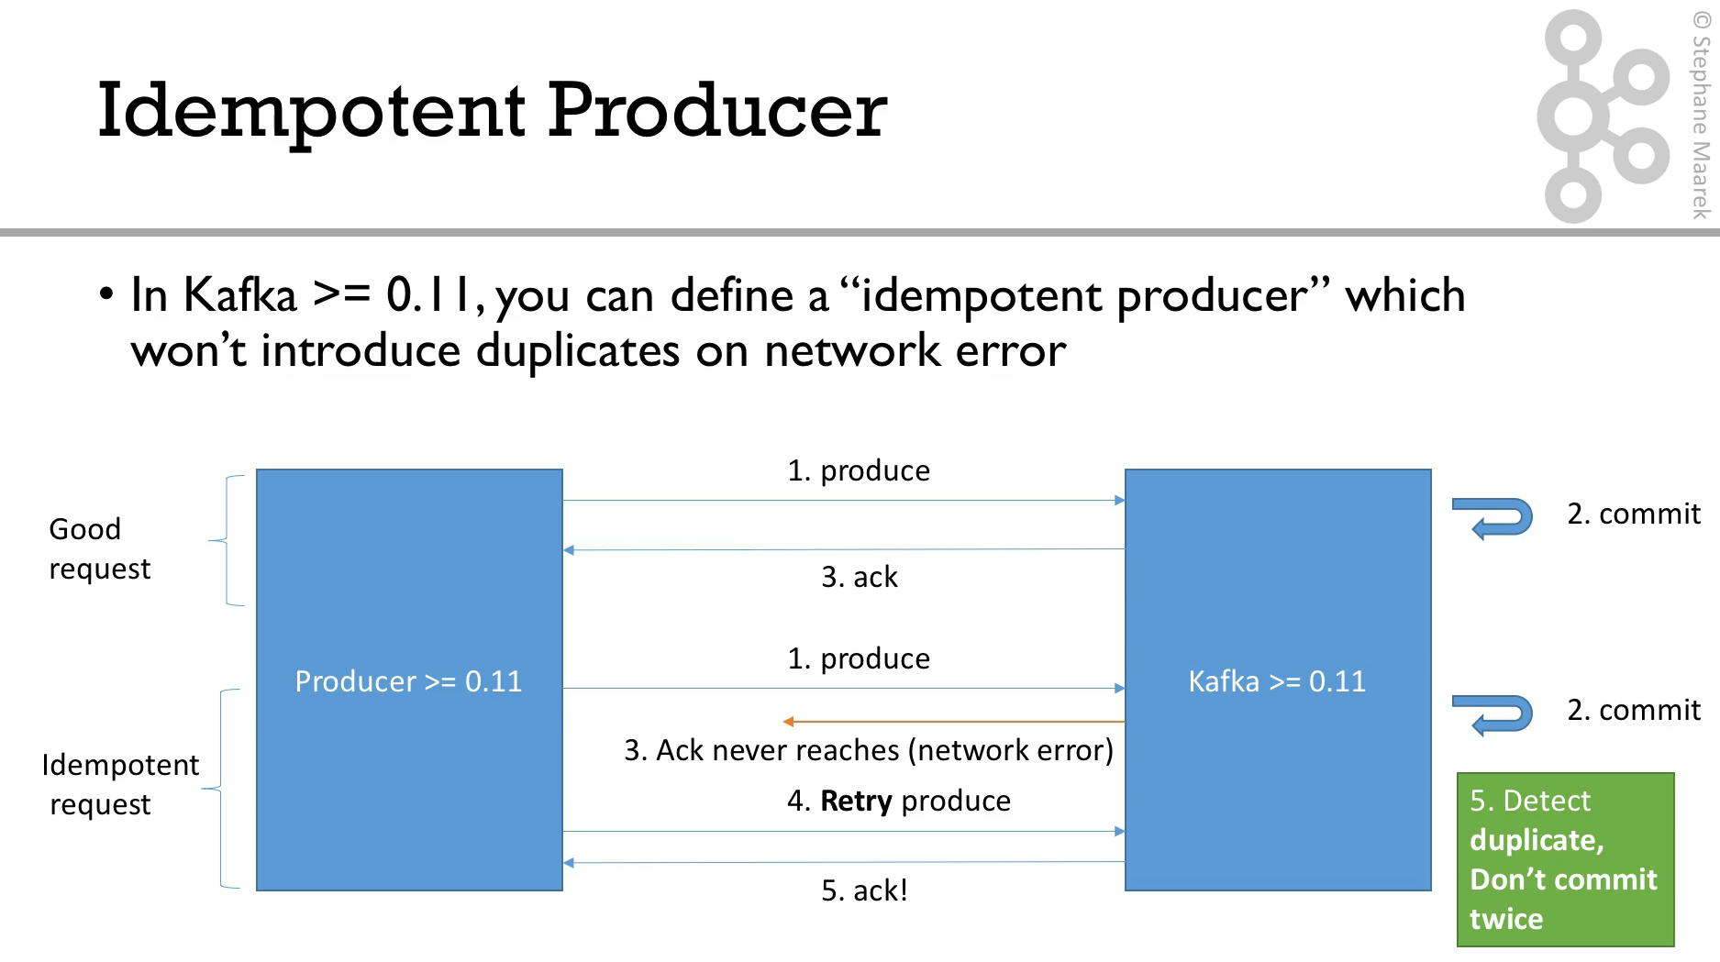

Slide 33
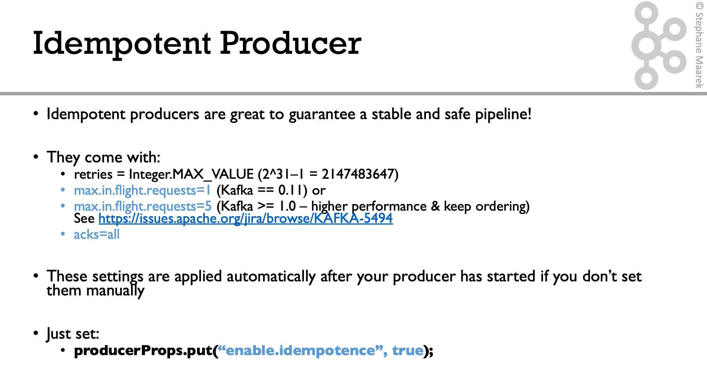
Notes:
Indempotent Producer
producerProps.pup(“enable.indempotence”, true);
The default configuration includes (Advice use de defaults or study this more carefully):
retries = 2174483647
max.in.flight.request = 5
acks=all
* max.in.flight.request. The maximum number of unacknowledged requests the client will send on a single connection before blocking. Note that if this config is set to be greater than 1 and enable.idempotence is set to false, there is a risk of message re-ordering after a failed send due to retries (i.e., if retries are enabled).

Slide 34
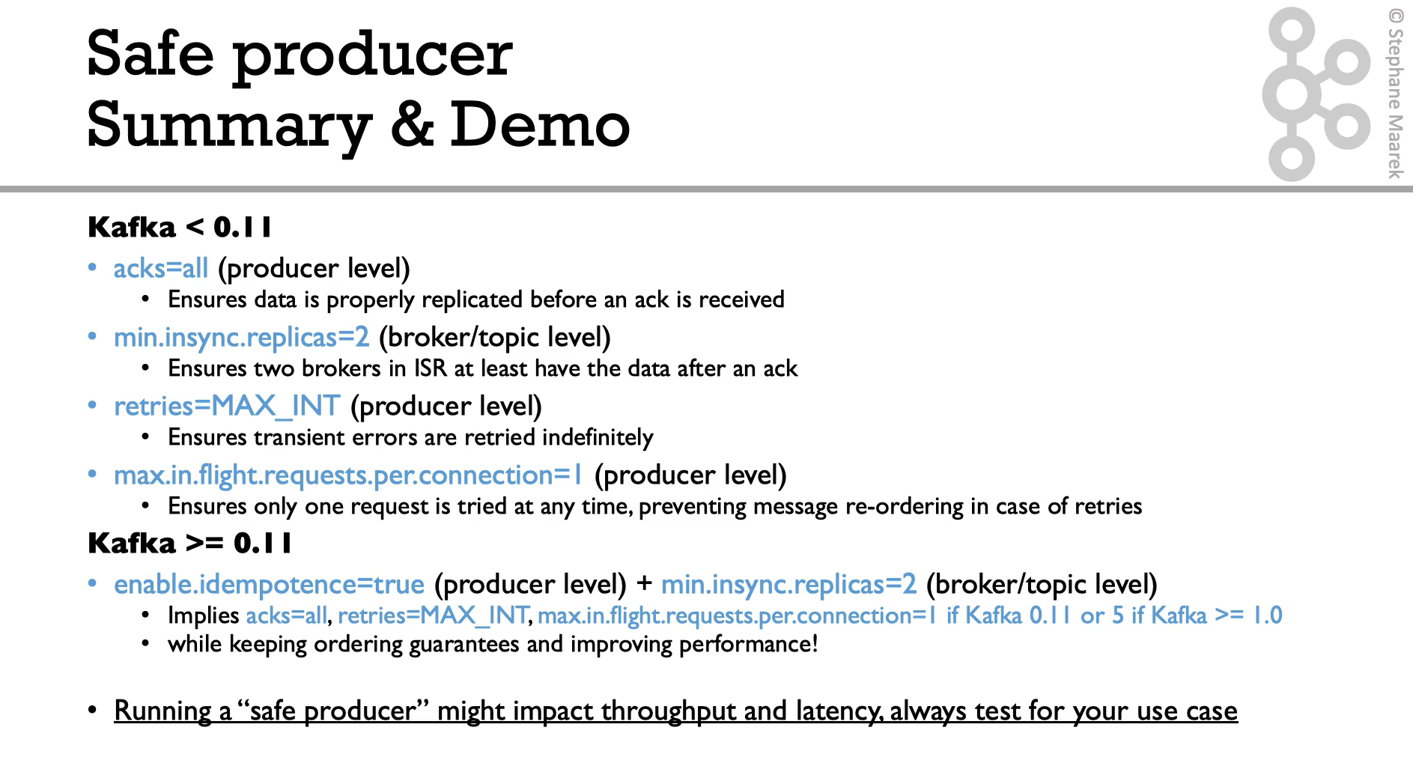

Slide 35
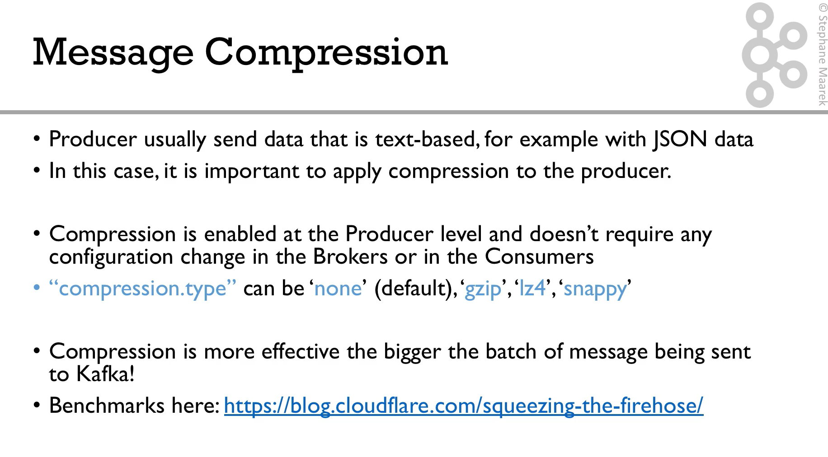

Slide 36
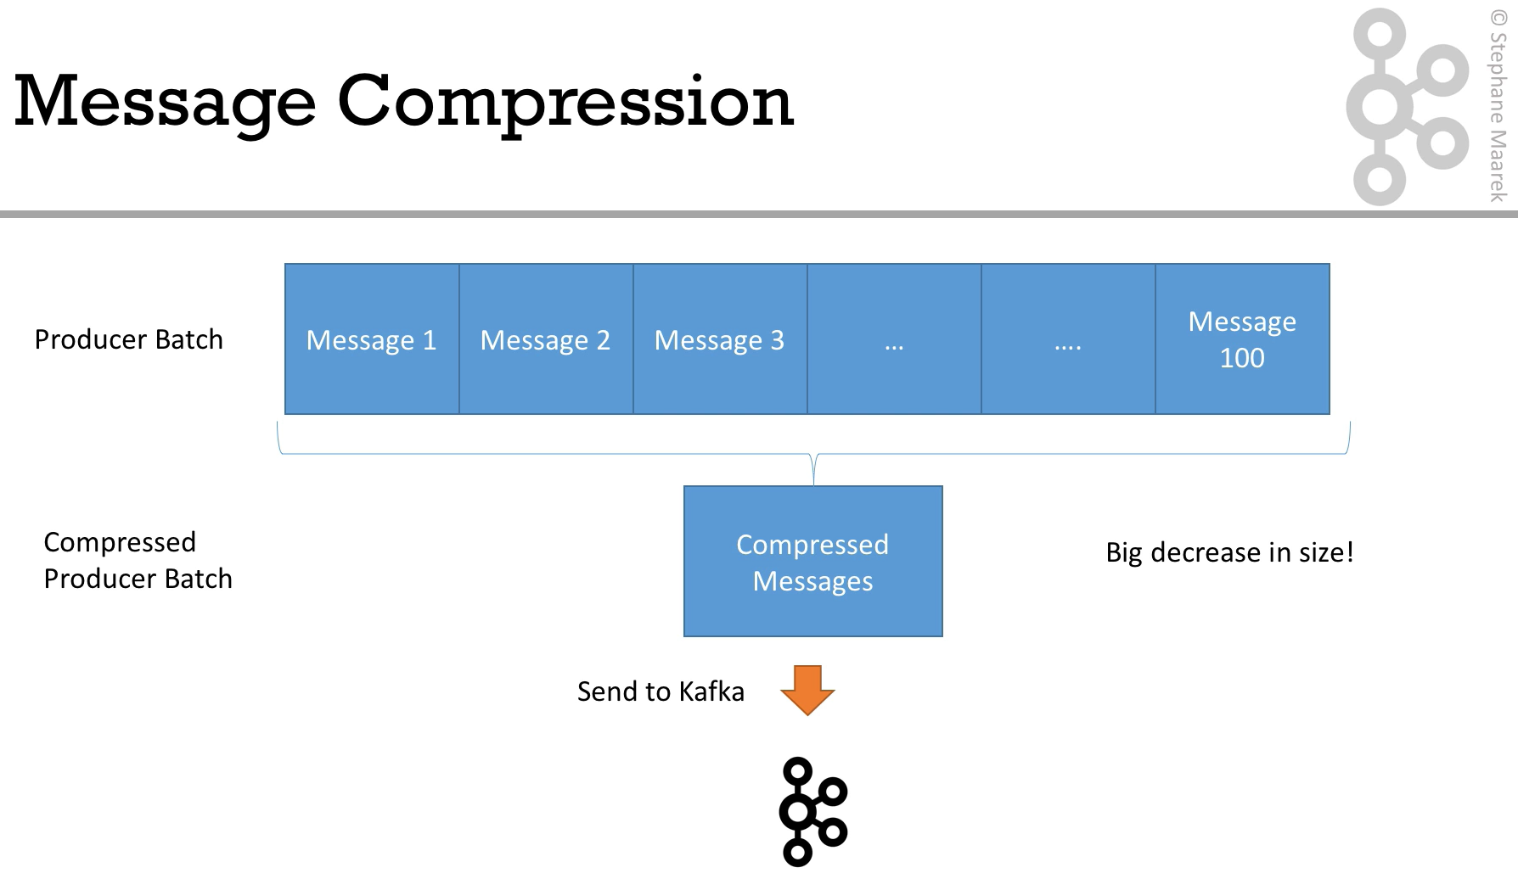

Slide 37
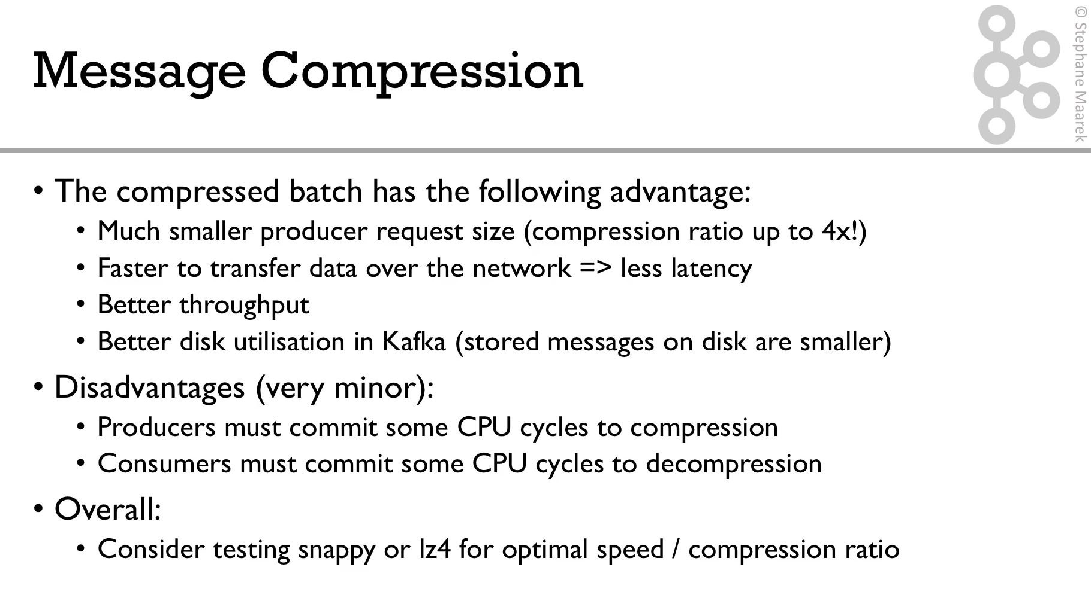
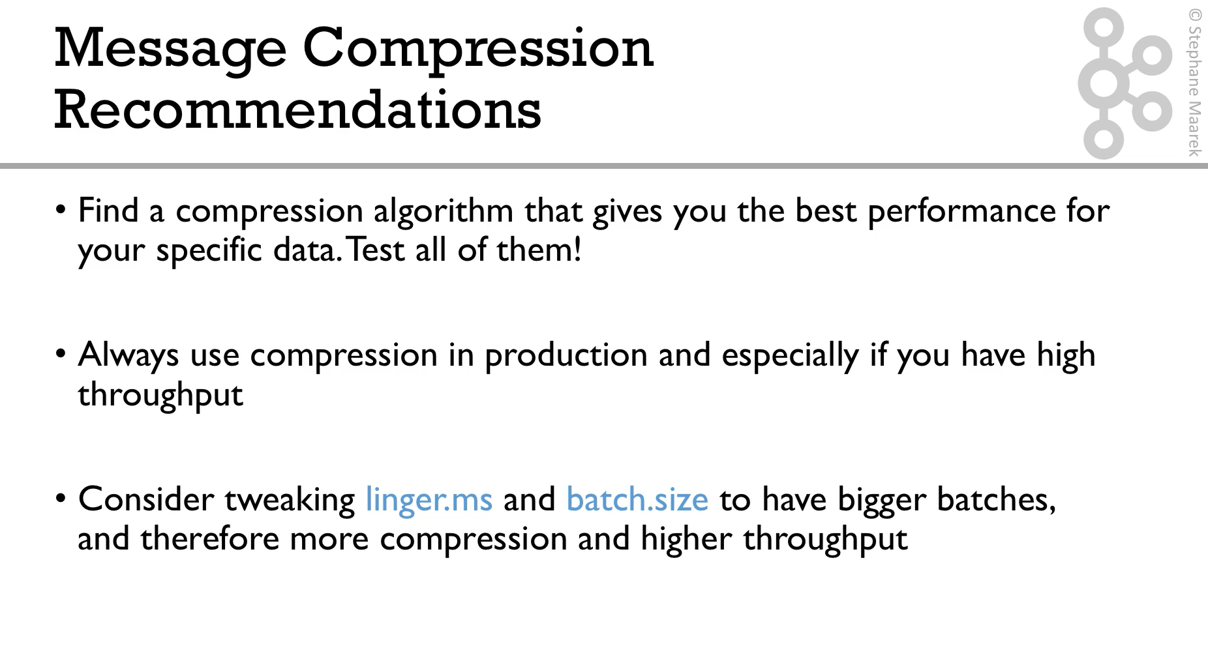

Slide 38
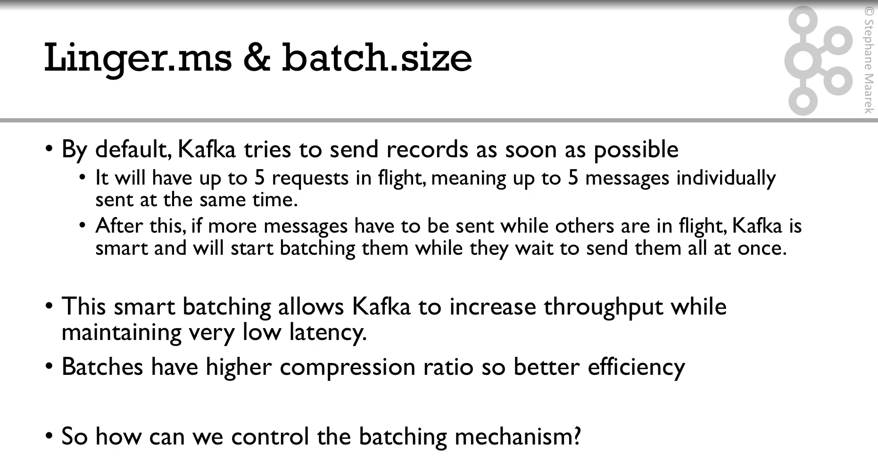
Notes:
linger.ms: number of milliseconds a producer is willing to wait before sending a batch out. (default 0).
batch.size: maximum number of bytes that will be included in a batch. The default is 16KB

Slide 39
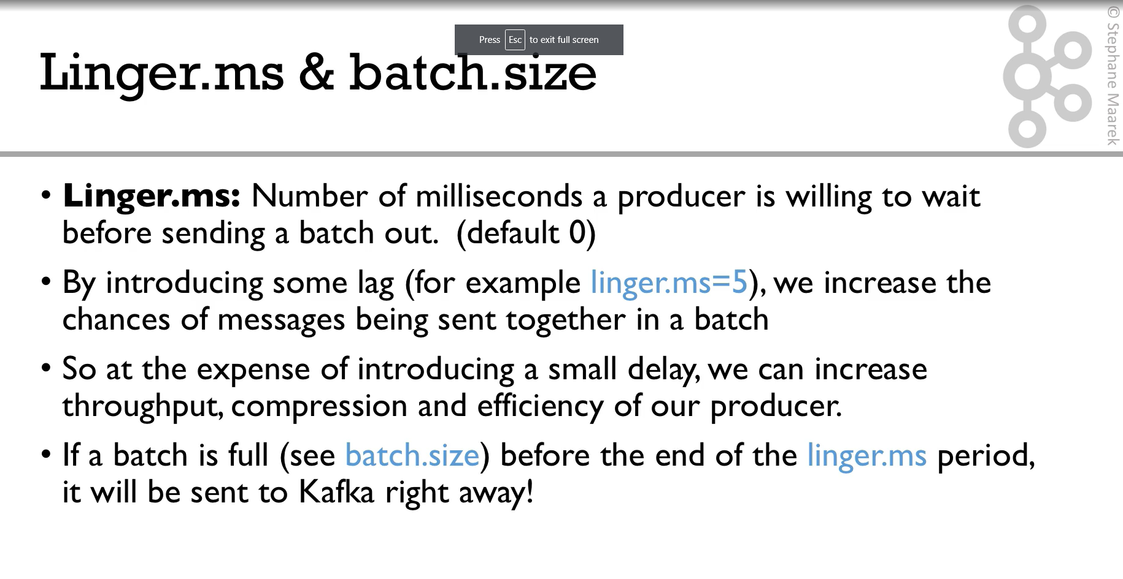

Slide 40
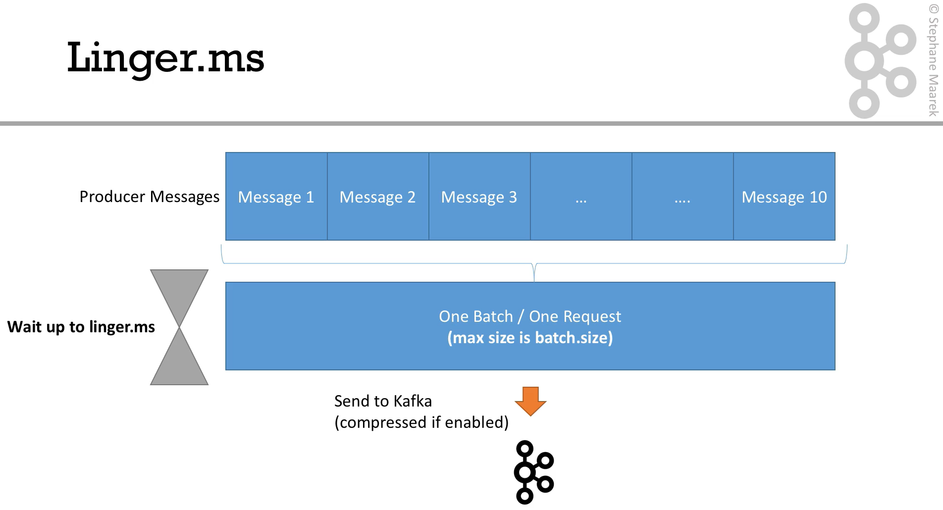

Slide 41
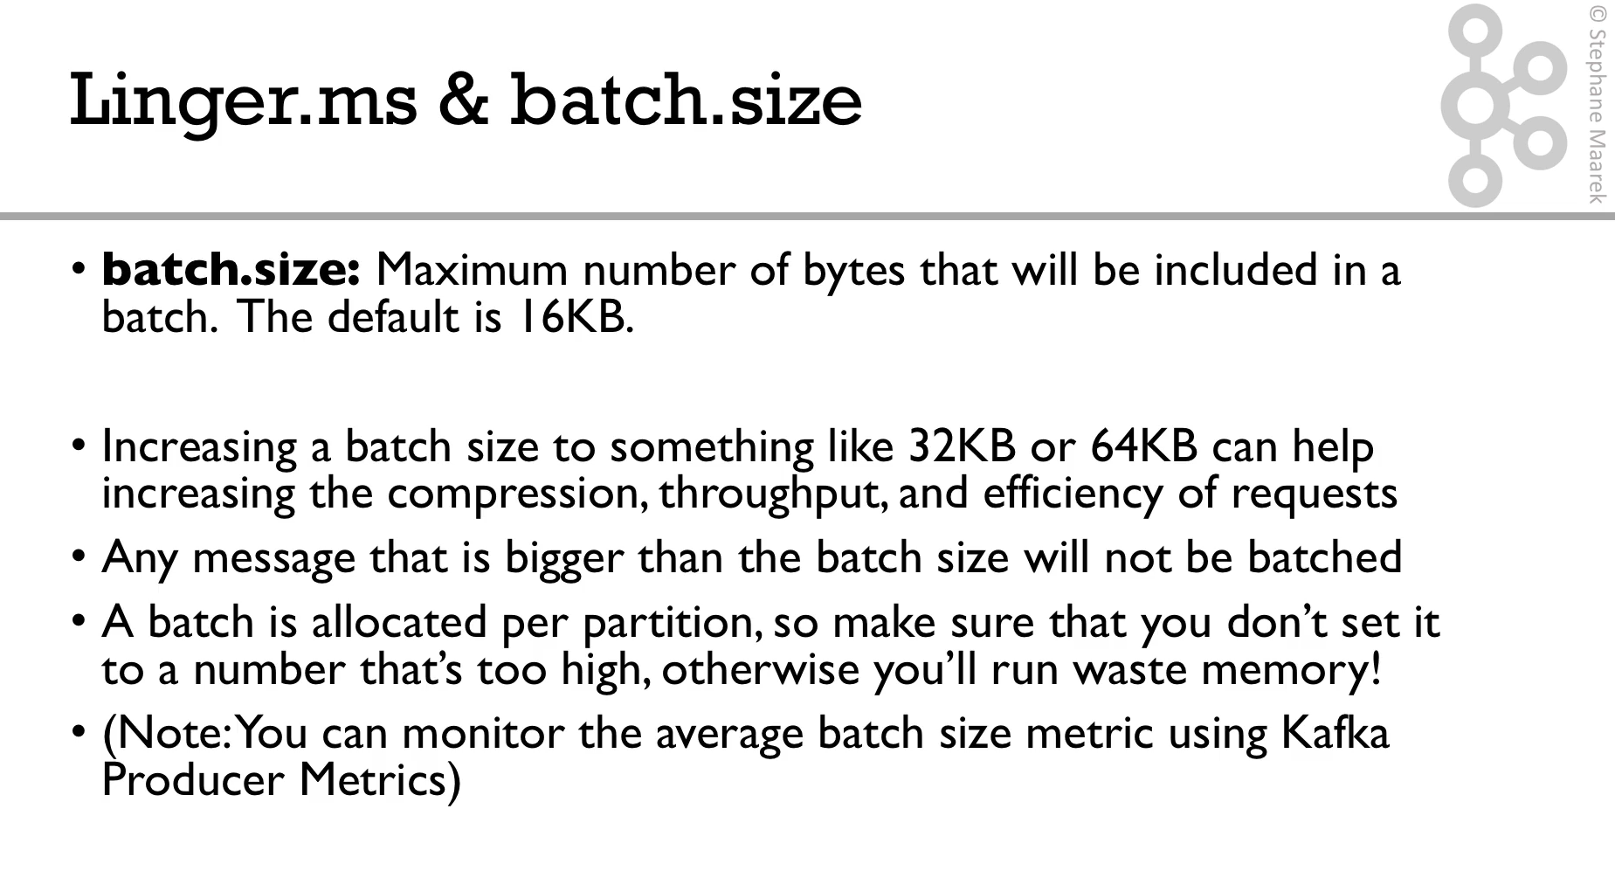

Slide 42
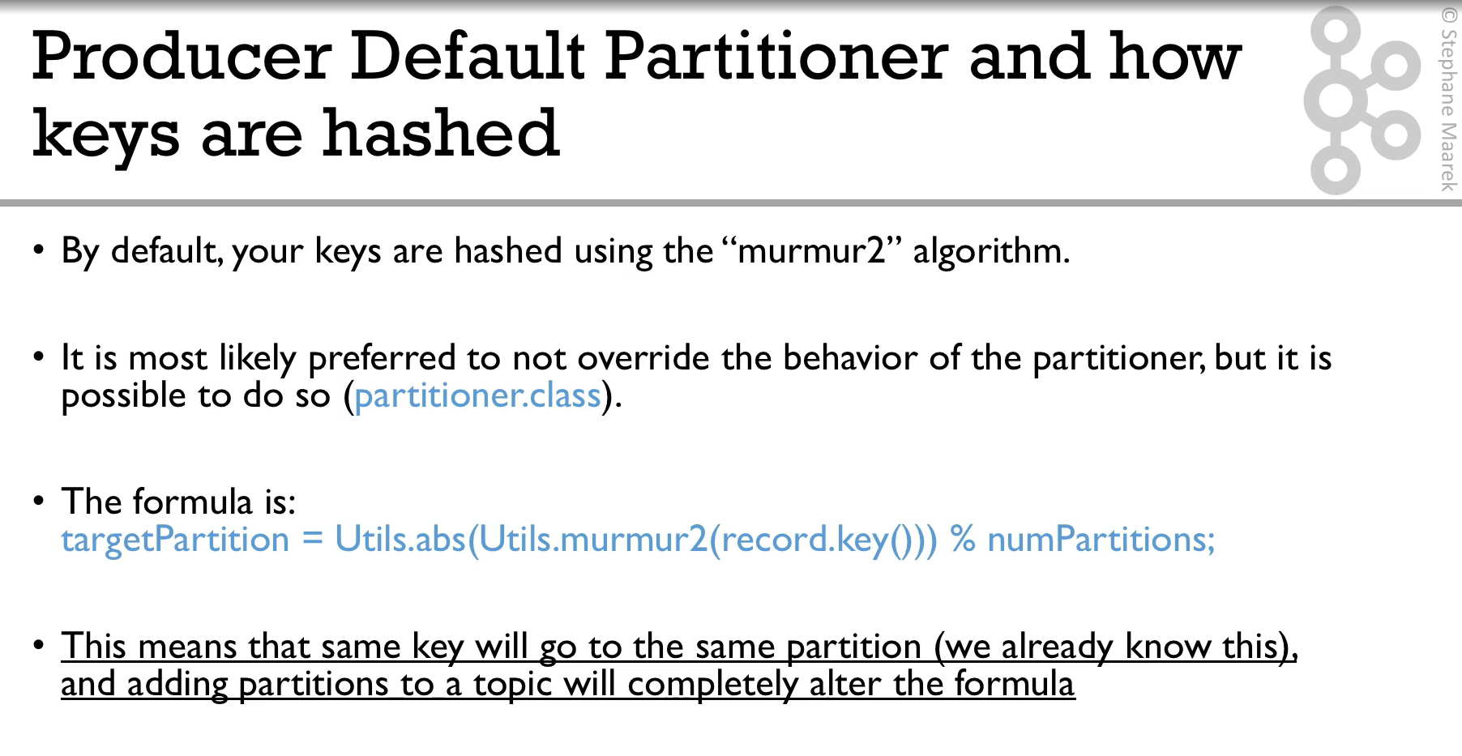

Slide 43
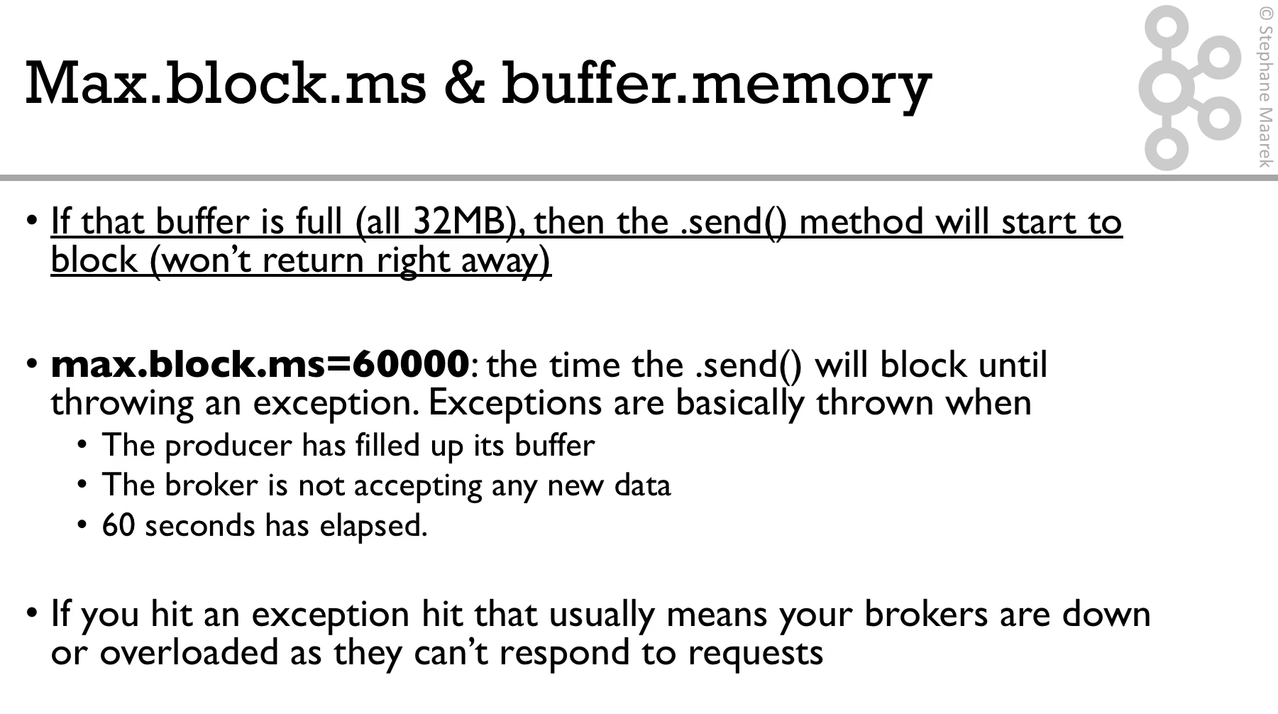

Slide 44
Consumer Performance Configuration

Slide 45
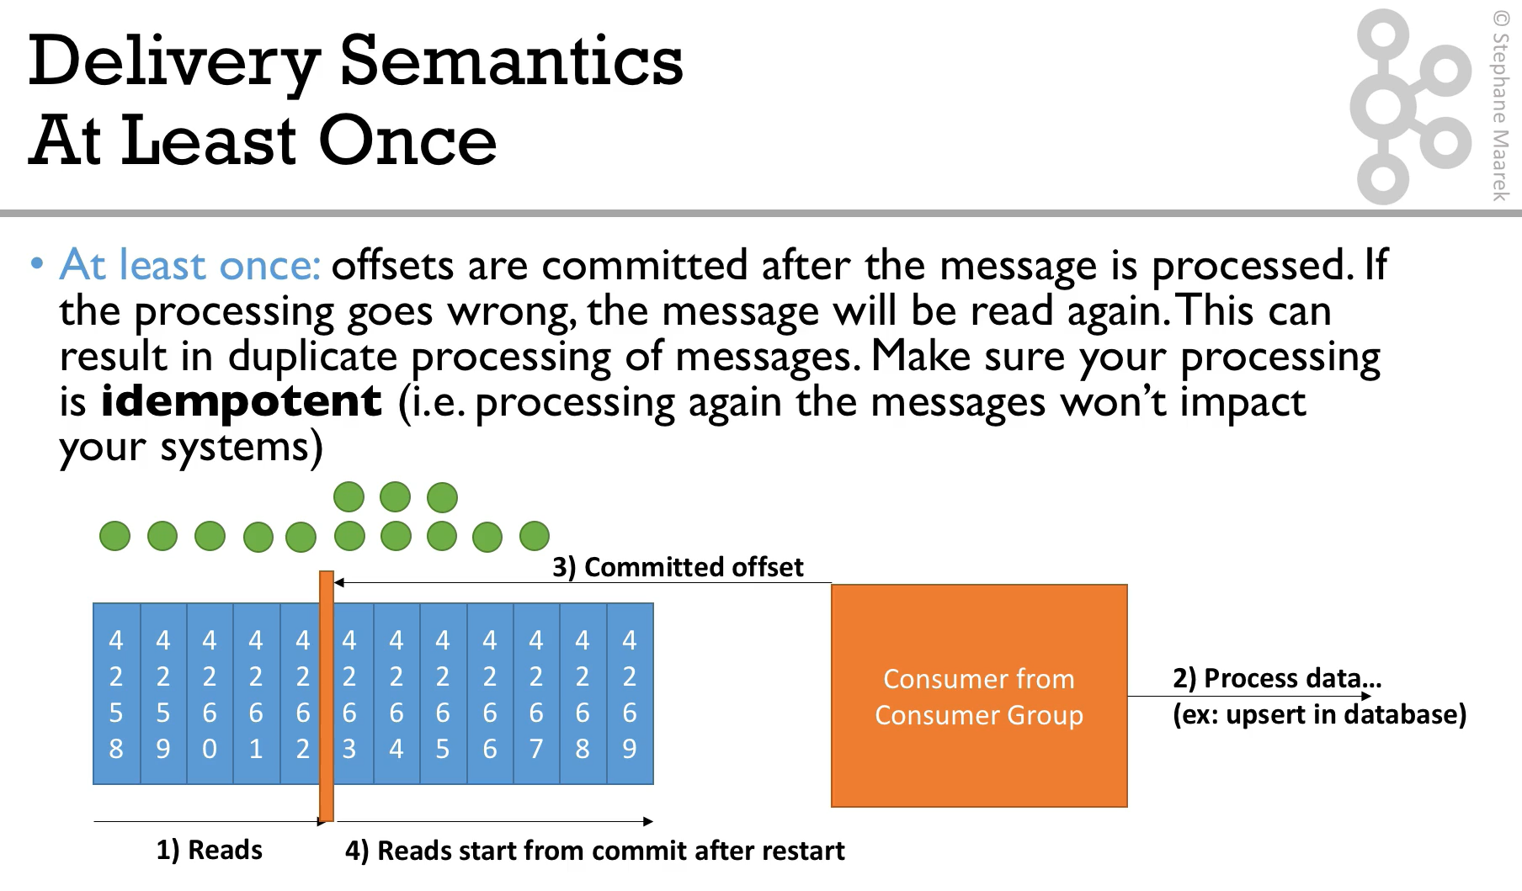
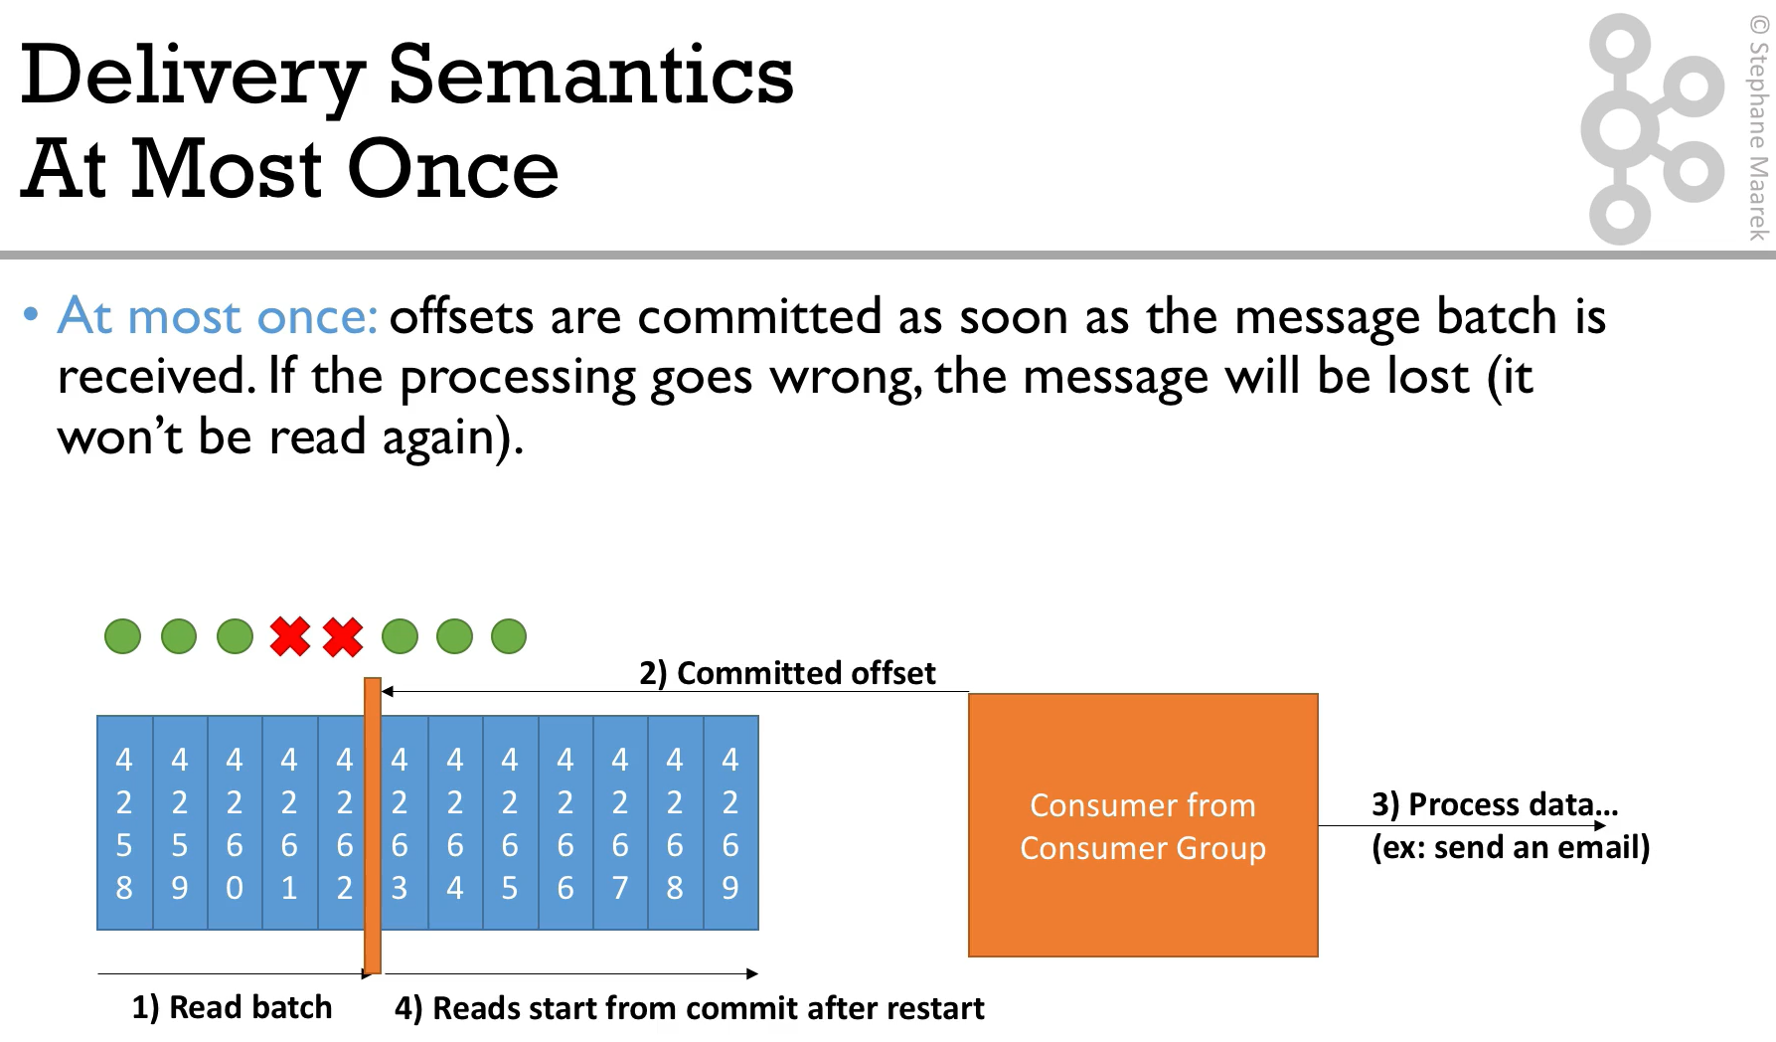
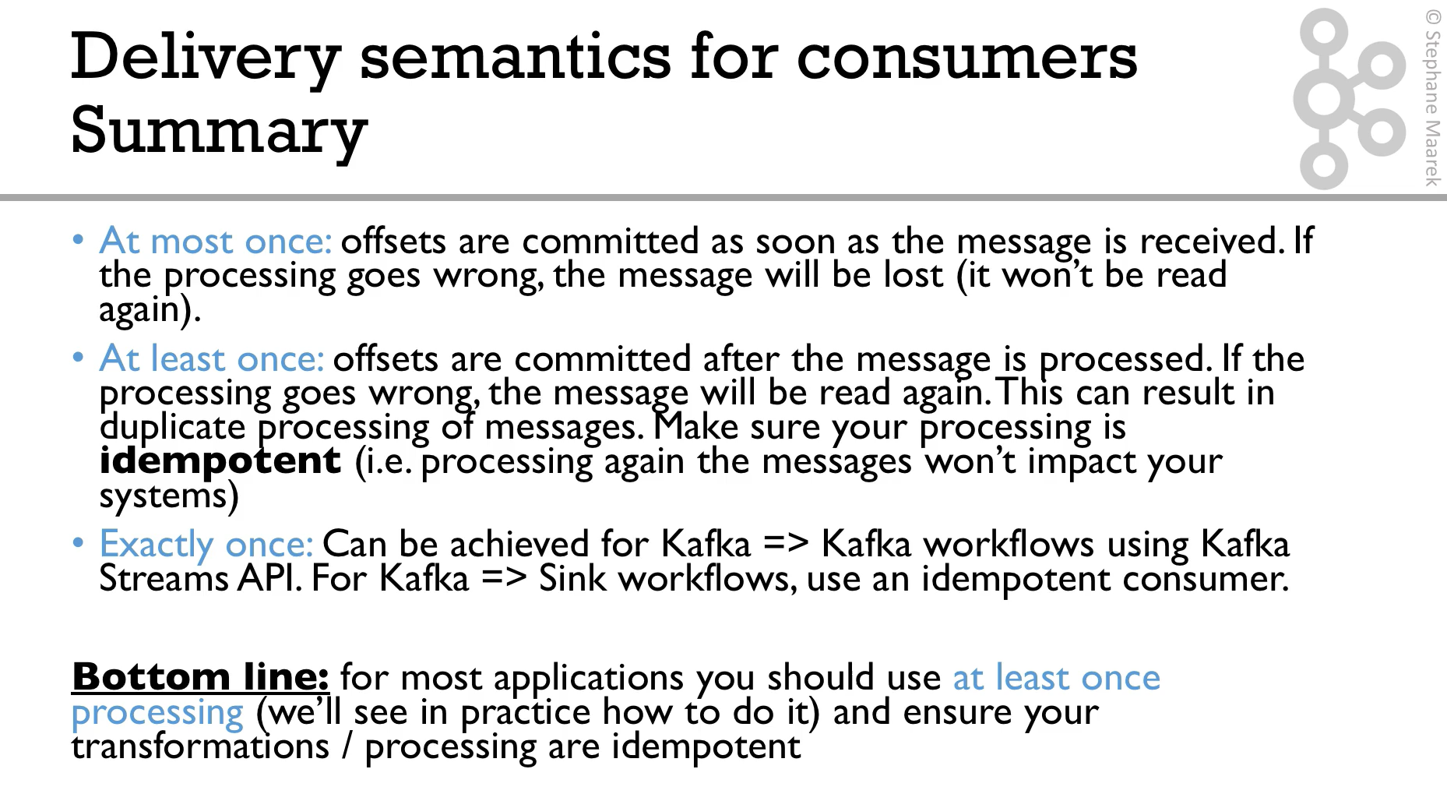

Slide 46
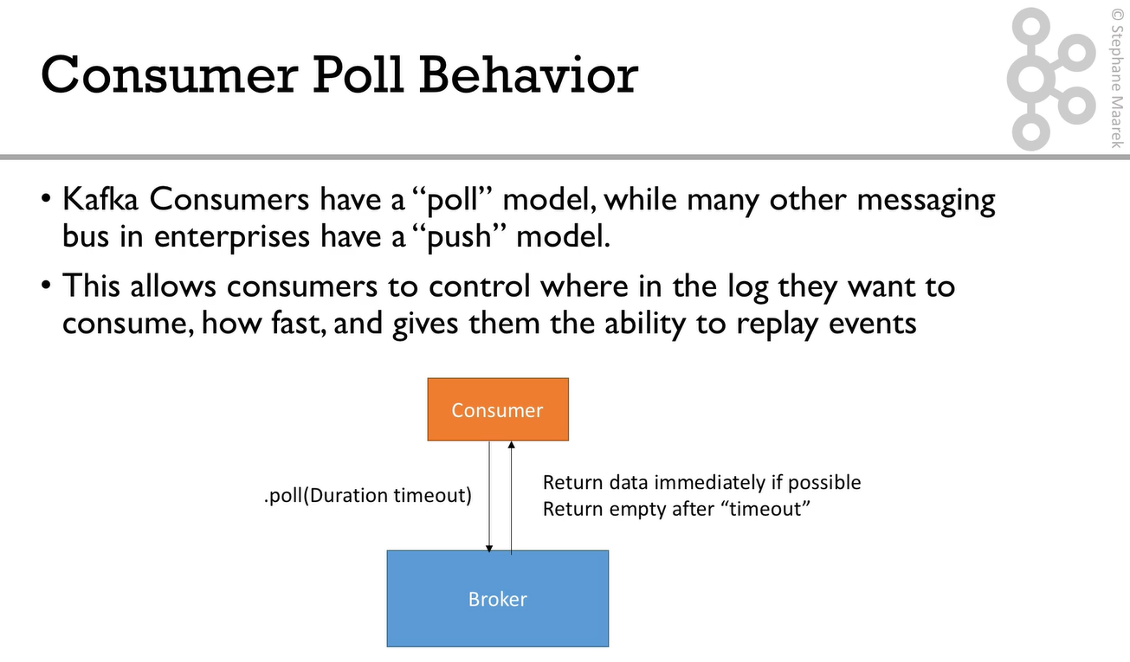

Slide 47
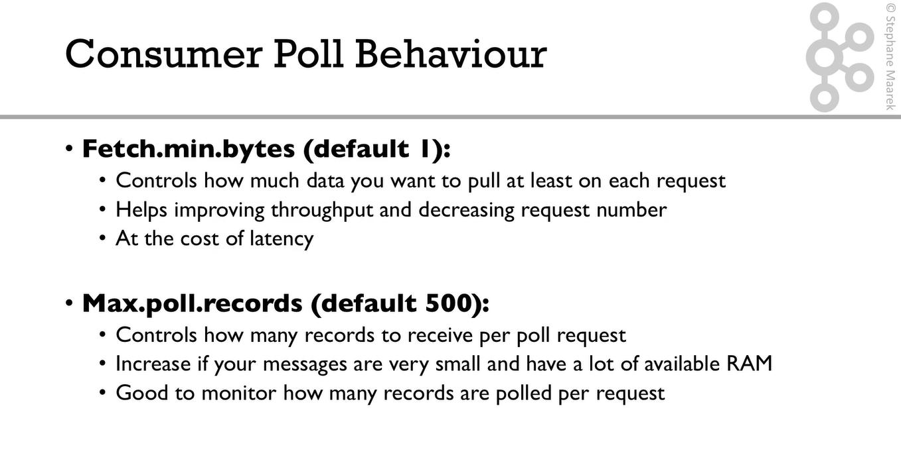

Slide 48
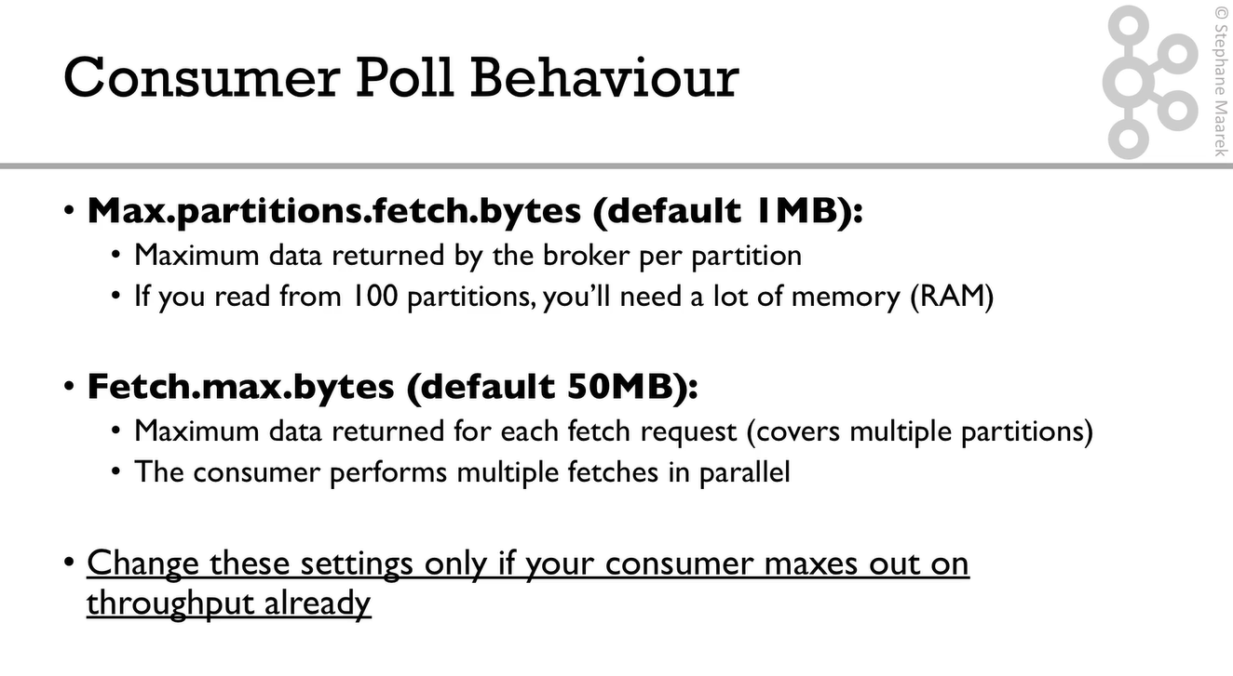

Slide 49
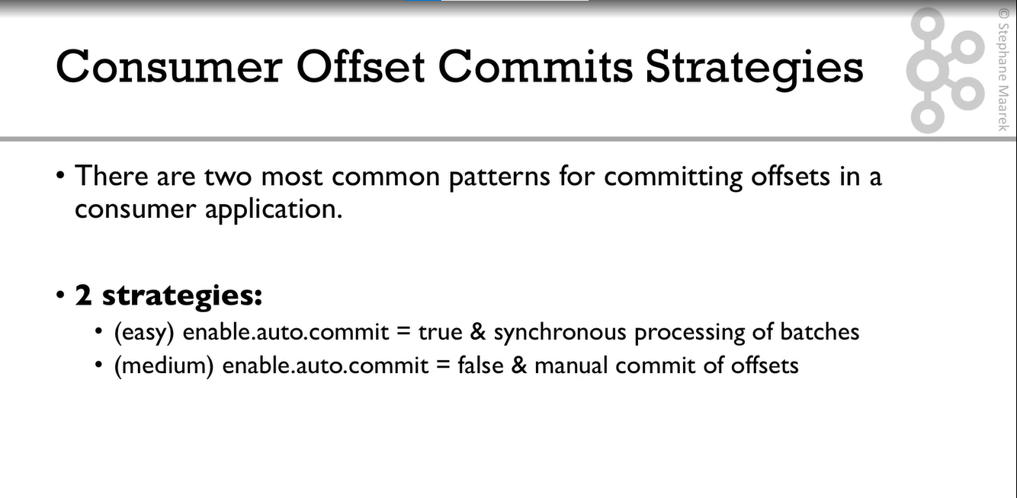

Slide 50

Notes:
Enable.auto.commit = true & synchronous processing of batches
Could be risky because you Will be in “at-most-once” behavior because offsets Will be committed before your data is processed

Slide 51

Notes:
enable.auto.commit = true & synchronous processing of batches
Could be risky because you Will be in “at-most-once” behavior because offsets Will be committed before your data is processed
enable.auto.commit = false & synchronous processing of batches
It is better because you only commit after your data is proccessed

Slide 52
Consumer Offset Reset

Slide 53


Slide 54


Slide 55

Notes:
Replaying data for consumeros
Take all the consumers from a specific group down
Use Kafka-consumer-groups command to set offset to what you want
Restart Consumers
Bottom line
Set proper data retention period & offset retention period
Ensure auto offset reset gehavior is hte one you expect /want
erlieast
latest
none
Use replay capability in case of unexpected behavior

Slide 56
Controlling Consumer Liveliness

Slide 57


Slide 58


Slide 59


